Slide 1
2023 NAIC Summer National Meeting
Senior Issues Task Force
August 13, 2023
eHealth
Gavin Galimi - SVP, General Counsel and Secretary
Charro Knight-Lilly - VP Compliance and
Chief Compliance Officer

Slide 2
eHealth is a leading online marketplace offering consumers a broad choice of insurance products from approximately 200 carriers that includes thousands of Medicare Advantage (MA), Medicare Supplement, and Medicare Part D plans (PDPs).
We also offer individual and family health insurance, small business coverage, and ancillary health insurance products.

Slide 3
For over 25 years, eHealth has expertly guided consumers through their health insurance and related options, when, where and how they prefer.
Our vision: Through strategic relationships with insurance carriers, eHealth will become the nation’s leading and most trusted source for consumer purchasing of health insurance, ancillary products and related options through a private marketplace.

Slide 4
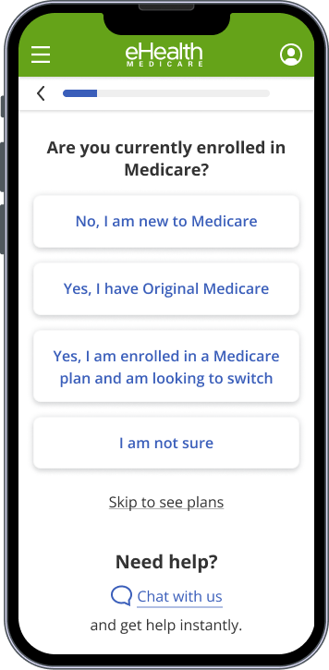
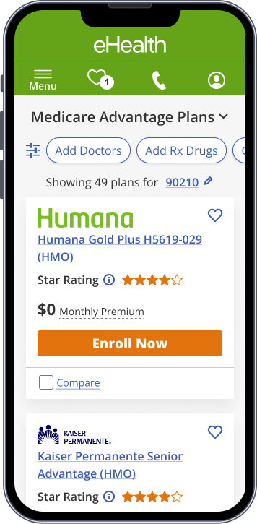
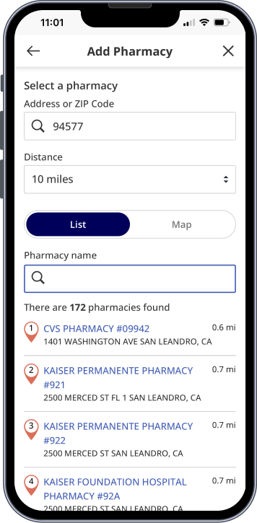
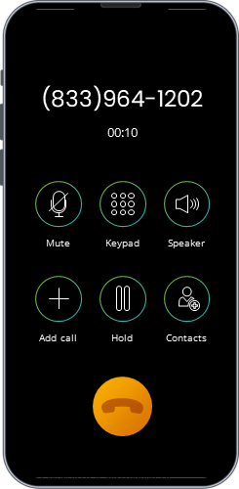
Customers
True Omni-Channel Experience
Online Assisted + Online Unassisted
Tele
Guided Shopping
Multi-plan
Multi-plan and Chat
Pharmacy
Phone
Personalized
Chat with licensed insurance advisor
Tech Enabled
Hey there, do you have any questions? We’re here to help.
Customer Driven
Start Chat
4
Notes:
We operate on a principle that the beneficiaries are not a homogenous group.
They have different preferences, tech proficiency and needs. Hence, we have built a tech-enabled platform that provides best in class experience based on their needs. We have built a truly omni-channel experience which enables us to meet customers in their terms.
While shopping on-line, if they need further help, we enable chat option with the live agent to help answer any questions that they may have. We help them narrow down plans based on whether their PCP or Pharmacy, Prescription is supported.
We also enable similar personalized tech-enabled and customer driven experience on tele channel as well, for those that prefer to speak directly with a licensed agent.

Slide 5
Cultivating long-term relationships with our customers is key to eHealth’s success.
Retention is a constant focus. If a customer cancels their plan, or if eHealth does not remain the broker of record, the commission revenue ceases.
Finding the right plan for each and every customer is essential.

Slide 6
Marketing Relationships
Relationships with Lead Generation Partners
Marketing relationships with lead generators may include:
Affiliate organizations
Online advertisers
Content providers
Other marketing vendors
eHealth generally compensates lead generators for their referrals of potential customers.

Slide 7
Marketing Relationships
Lead Generation Partner Services
Marketing partners, which include lead generation services, are a significant bridge for brokers and carriers to reach potential customers.
More effective in reaching potential customers who sign up to receive the partner’s marketing materials
Have invested in various ways of reaching customer segments, based on potential interests:
Suitability of product type
Qualifying plan type
Notes:
Partners may be better able to reach particular customer segments in a more effective manner than brokers or carriers advertising directly.

Slide 8
Valued Marketing Relationships
Marketing Partners
The success of the marketing partner relationship is dependent upon:
Compliance of the marketing partner with applicable laws, regulations and guidelines
Reputation and growth of the partner
Continued positive market presence
Ability to manage the partner
In recent years, the industry has experienced:
Some partners may be deceptive to consumers in their marketing message
Some partners may be deceptive to brokers and carriers about the sources of their referrals
When marketing partners fail to adhere to eHealth standards, they are subject to corrective action, up to and including termination of the relationship.

Slide 9
Valued Marketing Partners
Characteristics of good marketing partners (including lead generators):
Adherence with regulatory requirements
Referral of consumers actually interested in our products
Good long-term reputation and reliability
Indications there is a concern with a marketing lead:
Failure to adhere to regulatory requirements
Referrals who are confused or not actually interested in our products
Poor track record or short-term business focus

Slide 10
Valued Marketing Partners
How Insurance Commissioners Can Help
Distinguish between high-quality, reputable referral sources and fly-by-night deceptive referral sources
Continue to collaborate with eHealth on this topic

Slide 11
Gavin Galimi
SVP, General Counsel and Secretary
Gavin.Galimi@eHealth.com
Charro Knight-Lilly
VP Compliance and Chief Compliance Officer
Charro.Knight-Lilly@eHealth.com

