Slide 1
LONG-TERM CARE FRAMEWORK
LONG-TERM CARE FRAMEWORK

Slide 2
Long-Term Care Framework
Compact Statute ties LTC Uniform Standards to NAIC Model Law & Regulation: Standards shall provide “same or greater protections for consumers as, but shall not provide less than” the NAIC models, including subsequent amendments
    Uniform Standards amended in 2017 to incorporate 2016 amendments to NAIC Models #640 and #641.

Slide 3
Long-Term Care Framework
Scope of products reviewed: products advertised, marketed or offered to provide benefits for one or more of the following: nursing home care, assisted living care or home health care and adult day care
    LTC insurance definition follows NAIC Model #640 definition
    LTC insurance definition excludes life policies that accelerate death benefits for chronic illness or annuities with guaranteed living benefits when the guaranteed withdrawal increases for certain events
    Standards for Accelerated Death Benefits do not apply to the products/riders within scope of LTC Policy Standards
3

Slide 4
Long-Term Care Framework
Uniform Standards for LTC policies and rate schedules specifically cover all of these vehicles for providing LTC benefits:
    Stand-alone traditional LTC policy and rates
    Rider and rates to accelerate death benefit of life insurance policy or annuity contract—”Dollar for dollar LTC Insurance” as defined
    Rider and rates to extend LTC benefits after exhaustion of policy death benefits/annuity account value—Extension of Benefit rider

Slide 5
LTC Rate Review Overview
Rate Filing Standards apply rate stability framework from NAIC Model #641
    Actuarial memorandum required to contain “A statement that the initial premium rate schedule is sufficient to cover anticipated costs under moderately adverse experience and that the premium rate schedule is reasonably expected to be sustainable over the life of the form with no future premium increases anticipated”
Detailed criteria for review requiring rates to be reasonable, non-discriminatory, “based upon sound underwriting and sound actuarial principles reasonably related to actual or reasonably anticipated loss experience or expenses”
5

Slide 6
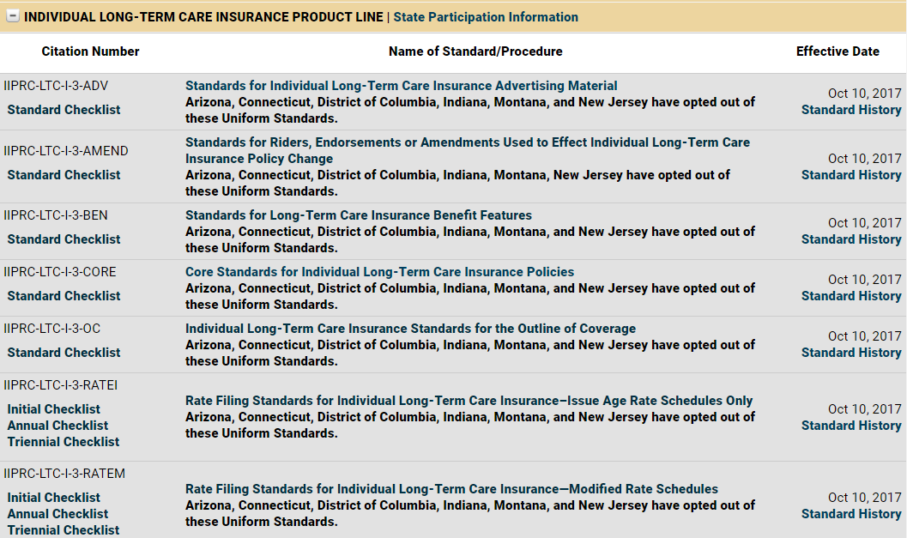
Uniform Standards on the Record
6

Slide 7
Uniform Standards requirements
Benefit trigger cannot be more than 2 activities of daily living (ADLs)
Exclusion based on mental or nervous disorders are not permitted
Exclusion due to a preexisting condition or disease limited to loss occurring within 6 months
Coordination of benefit provision not permitted
Must offer a product with inflation protection
Must offer a product with issue age rates
Must offer home health care benefits at 100% of nursing home benefits
For home health care benefit options, coverage requirement of 50% of nursing home benefit minimum

Slide 8
Uniform Standards requirements
Detailed information required for Initial Rate Filing
Sample Rate Assumptions Spreadsheet provided
Demonstration that margins do not deviate materially across issue ages
Annual actuarial certification for rates
  Currently marketed rates
  Closed forms
Triennial submission of supporting actuarial memorandum
Rate increase filing may not introduce a rating characteristic that was not relied on in the initial rate filing

Slide 9
Serving as a Resource for the Committee
The Compact Office takes no position on changes to the Model to accommodate designs that have been requested by the industry
The Compact Office is happy to provide reviewer and actuarial resources for technical assistance
SERFF Filing Access provides access to Compact-approved individual long-term care insurance products and riders
The Compact Office publishes an annual report on Compact-approved iLTC Rate Schedule Certifications --www.insurancecompact.org/documents/ic_ltc_rate_cert_report_201204.pdf
The Compact Office provides a state-specific report to each Compacting State on iLTC products / riders and annual rate certifications

Slide 10
Examining Flexibility of the Model
Guaranteed renewable limits products with fluctuating benefit designs
Specification page requirements limit fluctuating premium rate schedule designs
Benefit trigger is limited to inability to perform ADLs/cognitive impairment
  Limits designs which trigger on a time period such as 2 - 5 years before any benefit is payable even if policyholder becomes unable to perform ADLs
  Limits designs of converting life insurance to automatic LTC at certain point such a age 65
Rate stability limits ability to timely seek course corrections before MAE is gone
  Limits design allowing the premium rate schedule to fluctuate within a pre-approved range or band
  Limits periodic rate adjustments (smaller and more frequent)

