Slide 1
Navigating Climate Risks: Progress and Challenges in U.S. Insurance Sector Disclosures
July 9, 2024

Slide 2
Speakers
Steven Rothstein
Managing Director,
Ceres Accelerator for Sustainable Capital Markets
Jaclyn de Medicci Bruneau
Director of Insurance,
Ceres Accelerator for
Sustainable Capital Markets
Commissioner Mike Kreidler
Commissioner, Washington State Office of the Insurance Commissioner
David F. Snyder
Vice President, APCIA
Megan Hart
Global Head of Analytics and Collaborations, Climate Risk Advisory, AON
Emily (Emmy) Swift
Sustainable Business Framework Sr. Manager, AmFam Group

Slide 3
About Ceres
Ceres is a nonprofit advocacy organization working to accelerate the transition to a cleaner, more just, and sustainable world.
Ceres works with the world’s most influential investors and companies with the greatest impact on our economy to tackle our global sustainability challenges: climate change, water scarcity and pollution, and nature and biodiversity loss.
United under a shared vision, our powerful networks of investors and companies are proving sustainability is the bottom line—changing markets and sectors from the inside out. For more information, visit ceres.org.

Slide 4
Ceres Networks
Our powerful networks of investors and companies drive change while also advocating for innovative policies and regulations that build a cleaner, more just, and more sustainable economy.
Together, we spur innovation, change systems, and strengthen policies and regulations to drive bold economic transformations that will help protect people and the planet.
Ceres Investor Network
Ceres Company Network
Ceres Policy Network

Slide 5
The Ceres Accelerator for Sustainable Capital Markets aims to transform the practices and policies that govern capital markets by engaging federal and state regulators, financial institutions, investors, and corporate boards to act on climate change as a systemic financial risk. We educate and engage regulators, financial institutions, investors, and corporate boards to act on climate change as a systemic financial risk.
Launched in the fall of 2019, this center builds on the organization’s three decades of leadership in making and strengthening the business case for integrating sustainability into capital markets.

Slide 6
There is a growing international wave to consistent climate disclosure

Slide 7
Importance of Climate Disclosure for Insurers
Insurance regulators and industry have been working on climate disclosure guidelines for over a decade
In April 2022, NAIC endorsed TCFD as international standard for climate disclosure
For insurers representing 80% of the industry in several states (almost 500 insurers)

Slide 8
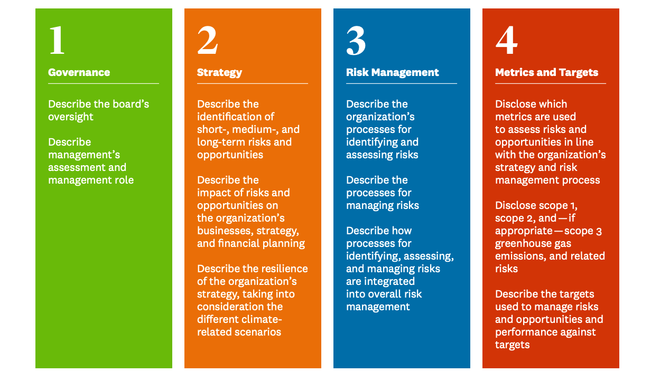
Core Elements of Recommended Climate-Related Financial Disclosures

Slide 9
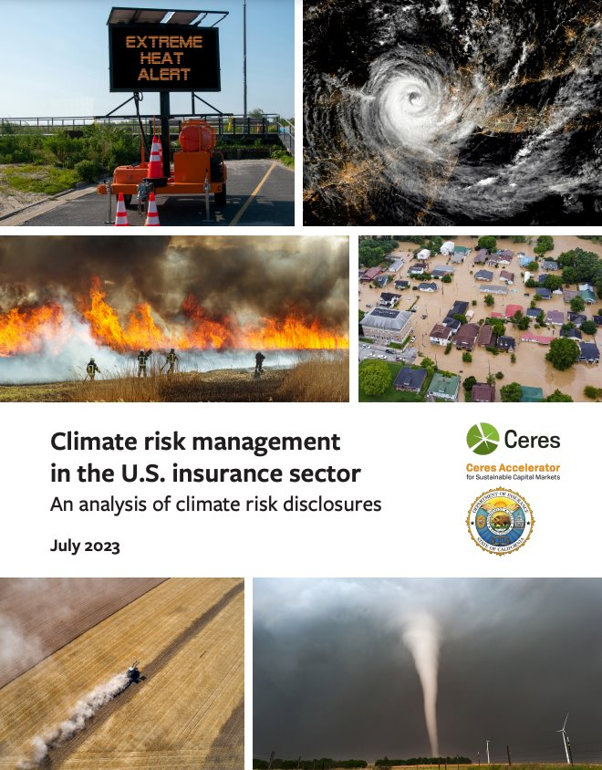
First TCFD Report

Slide 10
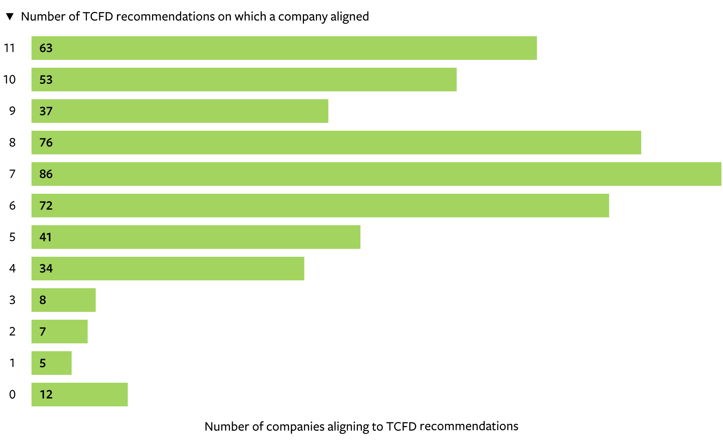
How Many of the TCFD recommendations did the responses follow?
63 reports provided information on all 11 TCFD recommendations.
78% of the reports provided information on 6 or more of the TCFD recommendations.
Results from Manifest Climate AI method

Slide 11
Responses according to the TCFD pillars
Strong response rates on Risk Management and Strategy; weak responses on Metrics & Targets
Results from Manifest Climate AI method

Slide 12
New Report

Slide 13
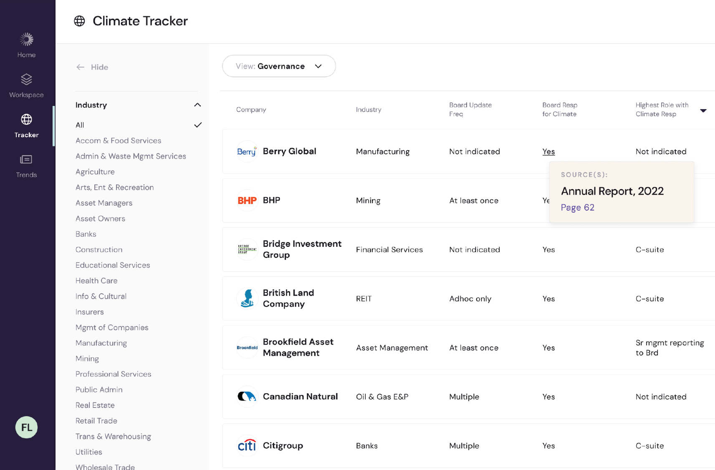
13
Manifest Climate Software
We designed a groundbreaking,
AI-powered software engine to help companies and investors accelerate their climate strategies.
2023 Manifest Climate Inc. All rights reserved.
Aligns
Disclosures with Requirements
Identifies
Risks &
Opportunities
Provides Competitive Benchmarks
Provides
A Clear Climate
Roadmap

Slide 14
Key Findings
Examples of companies across types of business (life, P&C, health) with detailed climate risk disclosure survey responses aligned with the TCFD framework
Diverse Strategies for climate risk management
Detailed responses on Risk Management and Strategy; less on Metrics & Targets
Over 95% of the reports provided information on Risk Management and Strategy
29% provided information on Metrics & Targets
Insurers describe purchasing reinsurance as their strategy for managing climate risk, while reinsurers describe repricing or reducing offerings to manage the same risks
Insurers rely on reinsurance providers for climate education, expertise, and resources​
Insurers offer products to support risk reduction among customers or support clean technology
Insights for Regulators

Slide 15
Second Year Results
Covers 516 groups representing nearly 1,700 individual companies
Conducted machine learning analysis of the thousands of pages
All regulators, insurers, advocates and other stakeholders will be able to explore the dashboards and read other TCFD reports

Slide 16
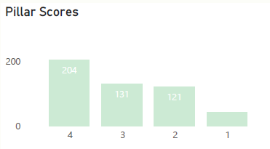
Insights and Analysis
AVERAGE ALIGNMENT
3 out of 4
PILLARS
5 out of 11
RECOMMENDATIONS
10 out of 41
ACTION ITEMS

Slide 17
Second Year Results

Slide 18
Second Year Results
Risk Management
Strategy
Governance
Metrics & Targets

Slide 19
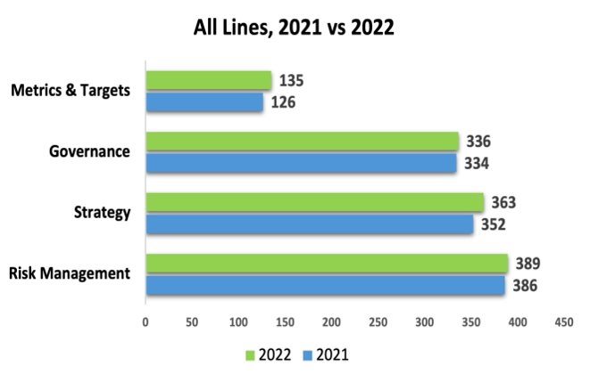
Second Year Results

Slide 20
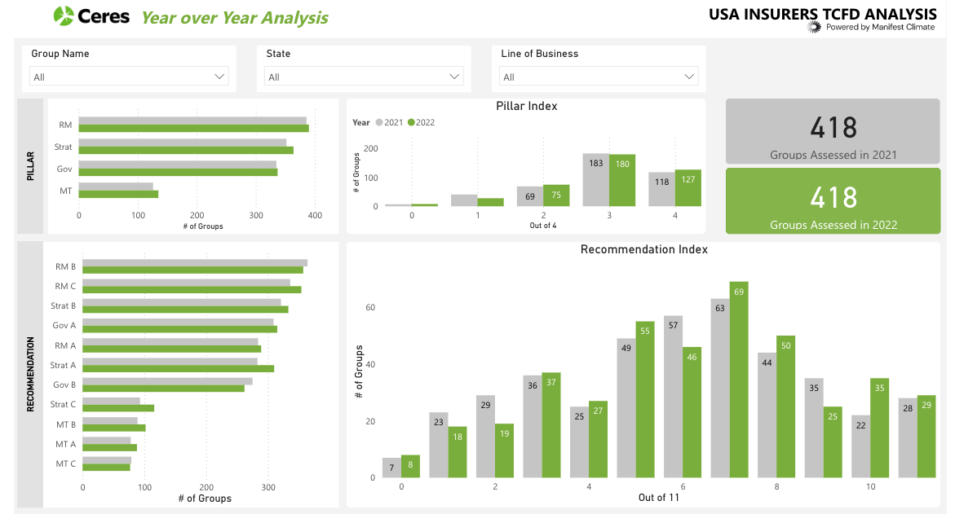
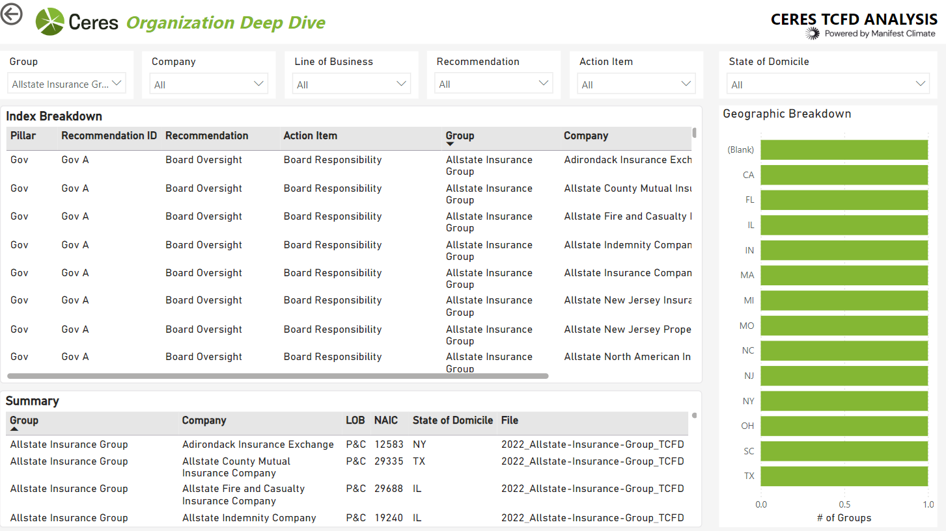
The Dashboard

Slide 21
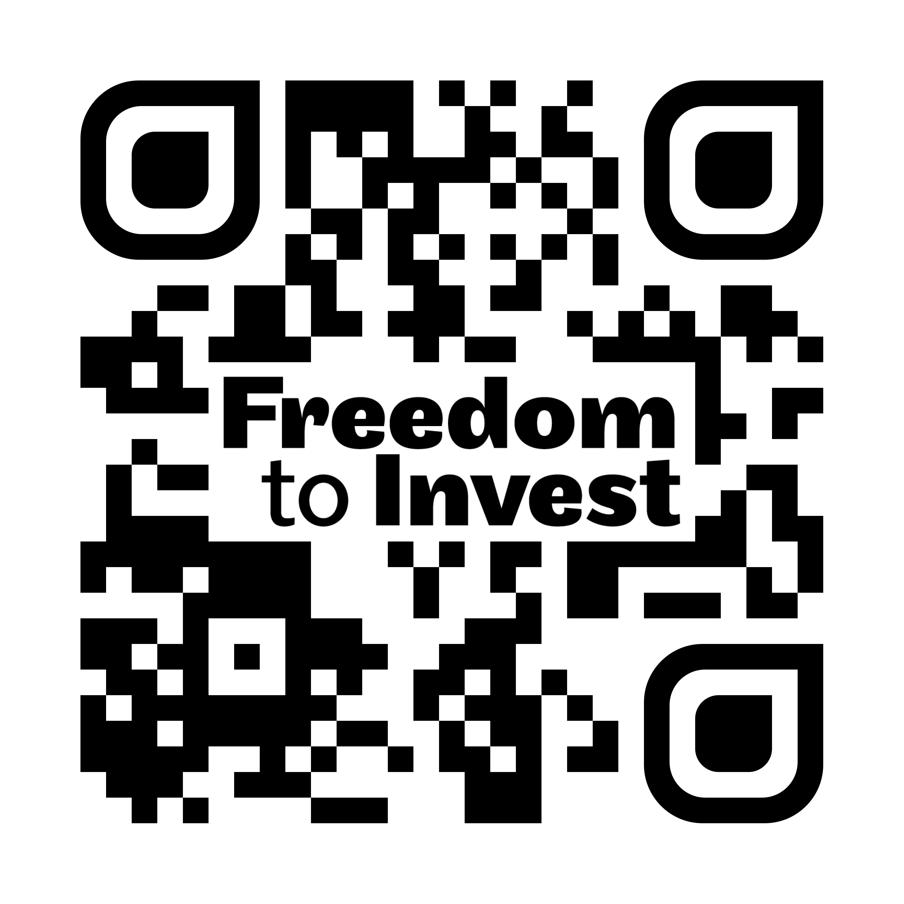
Protect the
Join leading investors and companies to call on policymakers to protect the freedom to invest responsibly.
Reaffirm your commitment to factoring all
material financial risks into decision-making.
Sign the Freedom to Invest statement
at: freedomtoinvest.org or scan QR code to learn more.

