Slide 1
Use of Data for Underwriting of Life Insurance Products

Slide 2
1. The industry moved into automated underwriting at an accelerated pace.

Slide 3
Most companies have started or are planning

Slide 4
New Terminology

Slide 5
Companies are pushing boundaries of what qualifies for AU

Slide 6
2. Home-grown solutions are the norm, but …

Slide 7
…companies often seek help from others

Slide 8
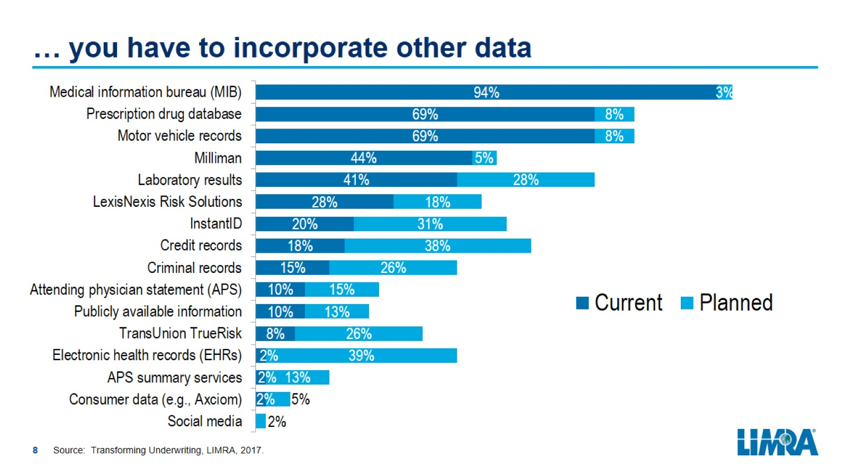
… you have to incorporate other data

Slide 9
3. Companies have many goals and are generally meeting them.

Slide 10
Companies have many goals

Slide 11
…and are generally meeting them

Slide 12
4. What automated underwriting solutions do

Slide 13
What they predict and how they do it

Slide 14
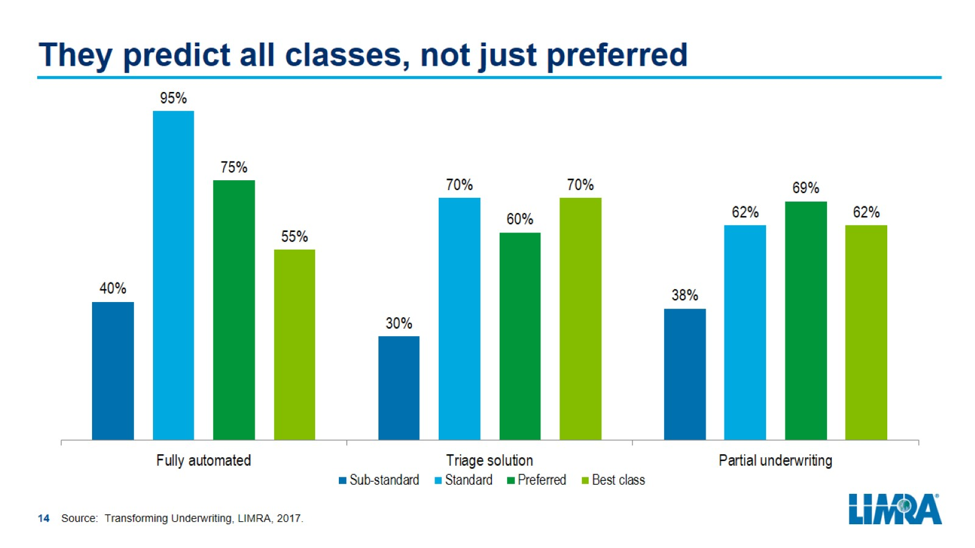
They predict all classes, not just preferred

Slide 15
5. Companies face multiple challenges

Slide 16
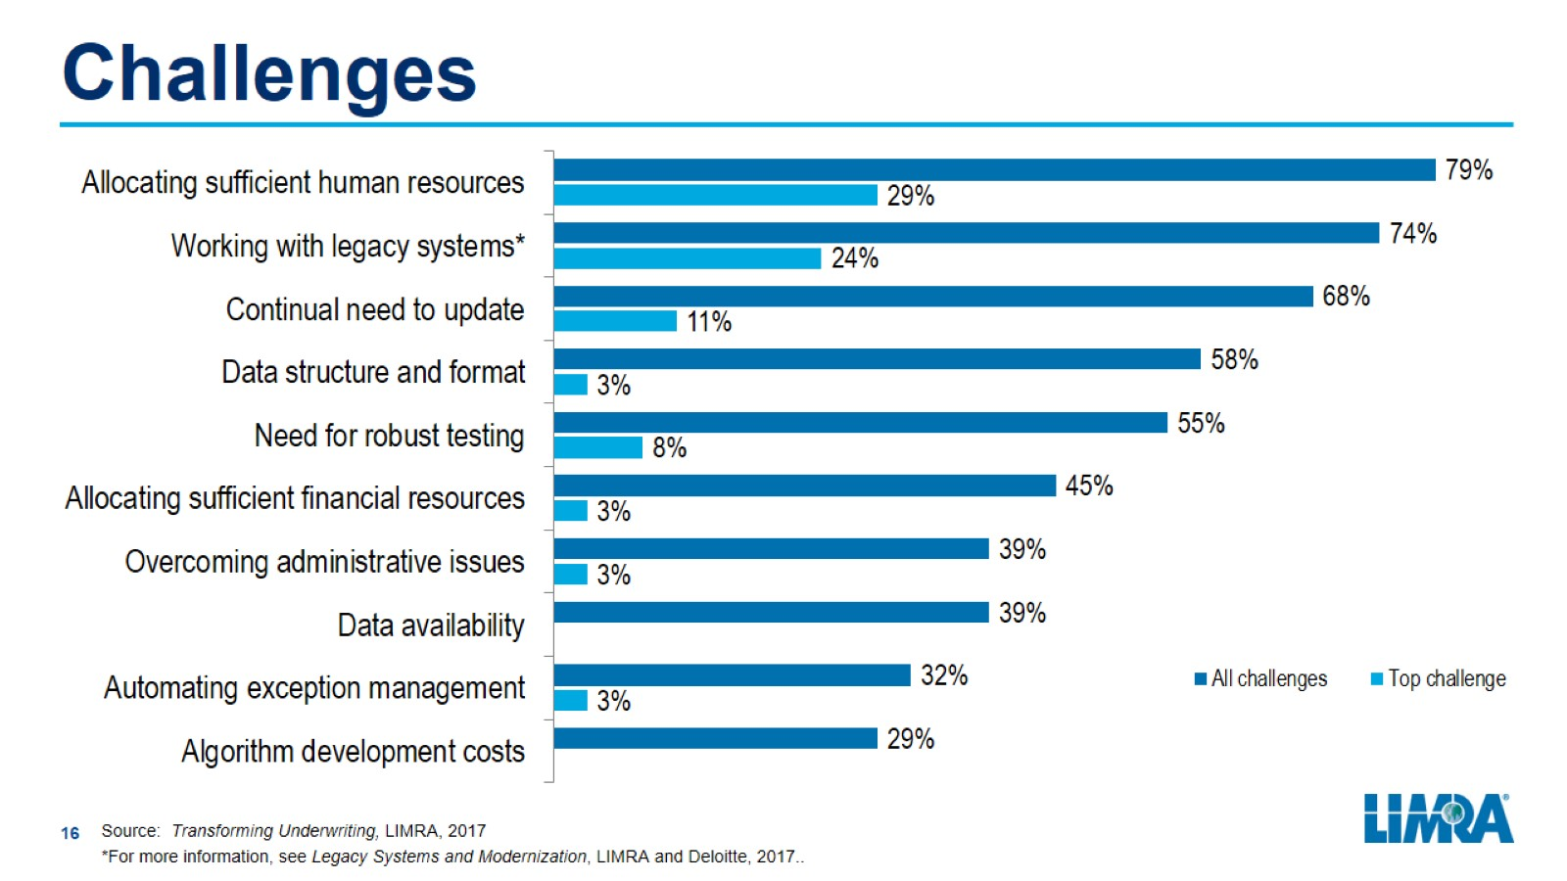
Challenges

Slide 17
Dealing with fraud and non-disclosure

Slide 18
Final Remarks

Slide 19
New SOA Study

