Slide 1
C-1 Subcommittee Update on
CLO C-1 Factors Modeling
March 2, 2026
Stephen Smith, MAAA, FSA, CFA
Chairperson, C-1 Subcommittee

Slide 2









About the Academy
Mission:
To serve the public and the U.S. actuarial profession
Community:
Serving over 20K
MAAAs & public stakeholders
for 60 years
Standards:
Setting qualification, practice, and professionalism standards
Impact:
Delivering over 300 insight-driven publications & resources annually
Visit www.actuary.org to learn more.

Slide 3
Introduction
The C-1 Subcommittee & the NAIC’s Structured Securities Group (SSG) have collaborated to build a working model for CLO C-1.
Modeled C-1 factors are shown based on ratings. The Academy has found ratings to include substantial information on tail risk so that ratings can serve as a comparable attribute when appropriate adjustments are made for horizon and tranche thickness.
Results are broadly consistent with work done by SSG in the CLO ad hoc group, showing low risk for senior tranches but potential cliff risk for junior tranches.
Factors are horizon-neutral.

Slide 4
Methodology Summary
Objective: Define several risk buckets for CLOs according to comparable attributes and then assign a C-1 factor to each bucket.
CLO collateral credit modeling is largely consistent with C-1 corporate bond modeling.
Projection of CLO cash flows is largely consistent with SSG modeling in the CLO Ad Hoc group, with the primary exception being the CLO collateral credit modeling.
Conversion of CLO cash flows into C-1 factors is consistent with C-1 corporate bond methodology where possible, with additional modeling to address the fact that missed payments on CLOs do not necessarily trigger defaults.

Slide 5
Anticipated Project Timeline
Sept. 8, 2025—initial presentation of model
Dec. 15, 2025—status update to regulators
Early 2026—presentation of residual tranche results, portfolio adjustment factor, model refinements, identification of potential comparable attributes, and resulting factors
Q1 2026—incorporation of modifications requested by regulators, if any
Q2 2026—If significant changes are not requested by regulators, expectation is for final factors to be available for exposure by April 30, 2026
WE ARE HERE

Slide 6
Acknowledgments
ACLI—use of C-1 corporate bond model developed by Moody’s for ACLI
Moody’s—access to CLO deal data, collateral data, historical default rate data, and CDOnet
S&P—historical recovery data and frequent discussions with structured finance analytical professionals
Bridgeway Analytics—frequent discussions on credit modeling, structured finance, and help in understanding the ACLI & Moody's corporate bond model
NAIC SSG—modeling advice and running CDOnet
NAIC Accounting Staff—guidance on CLO statutory accounting and reporting

Slide 7
C-1 Modeling Framework Flowchart
Considering C-1 for an asset class
Use existing C-1 factors
No
Yes
Similar risk vs. existing C-1 asset models?
Sufficient data?
Comparable attributes?
Practical to model individually?
Yes
No
No
Yes
Yes
See 2023-08-13 Academy presentation to RBCIRE for detailed description of this flowchart
Create new C-1 factors
Model assets individually

Slide 8
Project Status Update as of March 2, 2026
This presentation includes modeled base factors for CLO debt tranches.
The Academy will quickly follow-up with modeled portfolio adjustment factors and residual tranche treatment.

Slide 9
Key Definitions
Raw C-1 Factors refer to the factors estimated using a 3-step modeling process (collateral model, cash flow model, and C-1 factor model) for the universe of CLOs in-scope, as described in the American Academy of Actuaries materials presented at the September 3, 2025, and December 12, 2025, NAIC RBC IRE public calls. Raw C-1 Factors are unique to each asset.
Modeled C-1 Factors refer to the factors derived using the comparable attributes modeling approach described in this presentation. Modeled C-1 Factors apply to asset groupings.
Tranche Thickness is defined as the difference between the detachment point and attachment point, both expressed as a % of the CLO balance, for a given tranche.
Reinvestment Horizon is defined as the time during which a CLO can reinvest principal payments made on its collateral into new loans.

Slide 10
Modeled C-1 Factors for CLO Debt Tranches

Slide 11
Modeled Comparable Attributes
Modeled tail risk can be largely explained by a combination of three attributes: remaining reinvestment horizon, rating, and tranche thickness.
C-1 factors for other asset classes are horizon-neutral, therefore the C-1 factor for a given CLO debt tranche should not depend on its remaining reinvestment horizon.
After adjusting for systematic differences in reinvestment horizons across ratings, CLO debt tranches can be sorted according to two comparable attributes: rating and tranche thickness (with tranche thickness only needed for CLO debt tranches rated Baa3 and lower).
Tranche thickness can be treated in a simple manner, by dividing each rating into just two categories: tranche thickness greater than 4% and tranche thickness less than 4%.
Alternative results are also presented that ignore tranche thickness, prioritizing ease of implementation in a rating-only framework

Slide 12
Option 1—Rating Only (After-Tax Factors)
Investment Grade
Below Investment Grade
Rating | Simple Average Raw C-1 | Modeled C-1
Aaa | 0.03% | 0.03%
Aa1 | 0.28% | 0.04%
Aa2 | 0.00% | 0.04%
Aa3 | 0.00% | 0.04%
A1 | 0.40% | 0.14%
A2 | 0.11% | 0.14%
A3 | 0.12% | 1.45%
Baa1 | 1.58% | 1.81%
Baa2 | 3.02% | 2.70%
Baa3 | 5.94% | 2.73%
Rating | Simple Average Raw C-1 | Modeled C-1
Ba1 | 20.70% | 12.59%
Ba2 | 27.37% | 20.93%
Ba3 | 28.92% | 23.28%
B1 | 17.34% | 26.04%
B2 | 30.81% | 35.20%
B3 | 56.39% | 47.32%
Caa1 | 57.60% | 48.12%
Caa2 | 66.51% | 55.20%
Caa3 | 77.33% | 70.82%

Slide 13
Option 2—Rating & Tranche Thickness (After-Tax Factors)
Investment Grade
Below Investment Grade
Rating | Simple Average Raw C-1 | Modeled C-1
 |  | Thickness > 4% | Thickness ≤ 4%
Aaa | 0.03% | 0.03%
Aa1 | 0.28% | 0.04%
Aa2 | 0.00% | 0.04%
Aa3 | 0.00% | 0.04%
A1 | 0.40% | 0.14%
A2 | 0.11% | 0.14%
A3 | 0.12% | 1.45%
Baa1 | 1.58% | 1.81%
Baa2 | 3.02% | 2.70%
Baa3 | 5.94% | 2.73% | 12.52%
Rating | Simple Average Raw C-1 | Modeled C-1
 |  | Thickness > 4% | Thickness ≤ 4%
Ba1 | 20.70% | 12.59% | 22.39%
Ba2 | 27.37% | 20.93% | 30.72%
Ba3 | 28.92% | 23.28% | 33.08%
B1 | 17.34% | 26.04% | 35.84%
B2 | 30.81% | 35.20% | 44.99%
B3 | 56.39% | 47.32% | 57.12%
Caa1 | 57.60% | 48.12% | 57.92%
Caa2 | 66.51% | 55.20% | 64.99%
Caa3 | 77.33% | 70.82% | 80.61%

Slide 14
Appendix 1—Methodology for C-1 Factors

Slide 15
Methodology for Modeled C-1 Factors
Ordinary Least Squares (“OLS”) regression C-1 factor model
Adjustments for remaining reinvestment horizon
Adjustments for tranche thickness
Isotonic regression (on CLO debt tranches rated Baa2 and higher)

Slide 16
Methodology for Modeled C-1 Factors
1. OLS Regression Model
The OLS regression model used to produce Modeled C-1 Factors uses the following independent variables:
Ratings (19 indicator variables, one per rating)
Reinvestment horizon (1 numerical variable)
Interaction terms between reinvestment horizon and rating (6 interaction terms)
Tranche thickness (1 indicator variable)
The adjusted R² for a ratings-only regression is 74.2%. Adding reinvestment horizon increases the adjusted R² to 76.2%. Adding interaction terms between reinvestment horizon and ratings increases R² to 81.6%. Adding the tranche thickness flag increases R² to 83.2%.
C-1 factors are produced using an unweighted OLS, rather than weighted by $ balance.

Slide 17
Methodology for Modeled C-1 Factors
2. Adjustment for Remaining Reinvestment Horizon
We observe reinvestment horizon is predictive of raw C-1 factors; when a security has a shorter reinvestment horizon, its raw C-1 factor is on average smaller.
The effect of reinvestment horizon on C-1 varies by rating—C-1 and its slope is ~0 for Aaa/Aa but increases especially at Baa and below IG
Because Caa has materially fewer data points, we bucket Caa with B3 and offset all other ratings (i.e., B2/B1/Ba3 and Ba2/Ba1/Baa3 etc.) for the purpose of interaction terms which results in a minor improvement to R² and produces monotonicity for all below-IG ratings.
We observed no correlation between reinvestment horizon and rating (p-value = 0.19). Because non-CLO C-1 factors are horizon-neutral, the modeled C-1 factors are derived by using the average reinvestment horizon across ratings of 2.41 years (balance-weighted average is near-identical at 2.40 years).

Slide 18
Methodology for Modeled C-1 Factors
3. Adj. for tranche thickness and 4. Isotonic Regression (Baa2 / above)
After adjusting for reinvestment horizon, an isotonic regression is applied to produce monotonic C-1 factors across rating.
Rating | Simple Average Raw C-1 | Modeled C-1, Reinvestment Adjusted | Modeled C-1, Isotonic Regression Applied
Aaa | 0.03% | 0.03% | 0.03%
Aa1 | 0.28% | 0.27% | 0.04%
Aa2 | 0.00% | 0.00% | 0.04%
Aa3 | 0.00% | 0.04% | 0.04%
A1 | 0.40% | 0.41% | 0.14%
A2 | 0.11% | 0.10% | 0.14%
A3 | 0.12% | 1.45% | 1.45%
Baa1 | 1.58% | 1.81% | 1.81%
Baa2 | 3.02% | 2.70% | 2.70%
Note that the shift in A3 from 0.12% simple average of raw C-1 to 1.45% with reinvestment adjustment is due to the relatively short horizons present in the A3 tranches in the dataset. Also note that A3 tranches are less common than A2.

Slide 19
Methodology for Modeled C-1 Factors
3. Adjustments for tranche thickness (Baa3 / below)
Factors are monotonic after spiking out thickness and accounting for horizon
Rating | Simple Average Raw C-1 | Simple Average Raw C-1 |  | Modeled C-1, Reinvestment Adjusted
 |  | Thickness > 4% | Thickness ≤ 4% | Thickness > 4% | Thickness ≤ 4%
Baa3 | 5.94% | 2.33% | 16.27% | 2.73% | 12.52%
Ba1 | 20.70% | 3.39% | 26.09% | 12.59% | 22.39%
Ba2 | 27.37% | 8.82% | 38.13% | 20.93% | 30.72%
Ba3 | 28.92% | 19.87% | 35.61% | 23.28% | 33.08%
B1 | 17.34% | 13.68% | 53.96% | 26.04% | 35.84%
B2 | 30.81% | 12.68% | 65.04% | 35.20% | 44.99%
B3 | 56.39% | 31.15% | 57.35% | 47.32% | 57.12%
Caa1 | 57.60% | 35.50% | 67.07% | 48.12% | 57.92%
Caa2 | 66.51% | 39.12% | 70.16% | 55.20% | 64.99%
Caa3 | 77.33% | 74.61% | 81.47% | 70.82% | 80.61%

Slide 20
Appendix 2—Modeling Choices

Slide 21
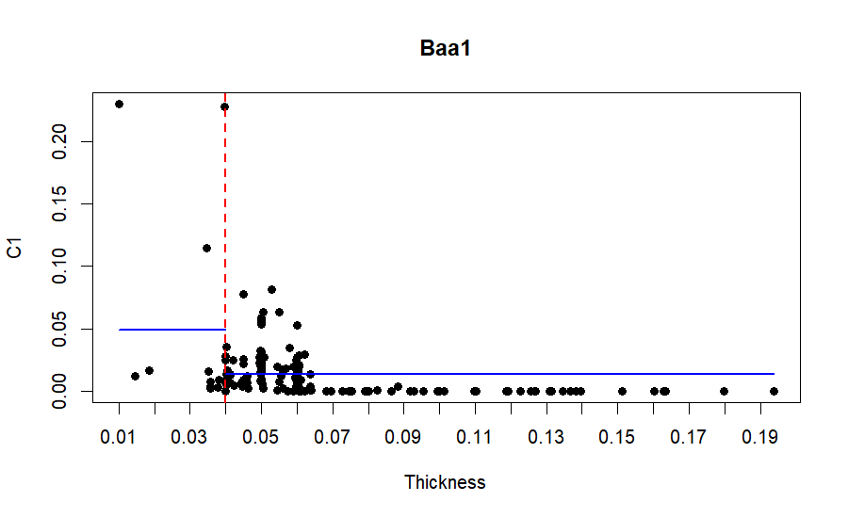
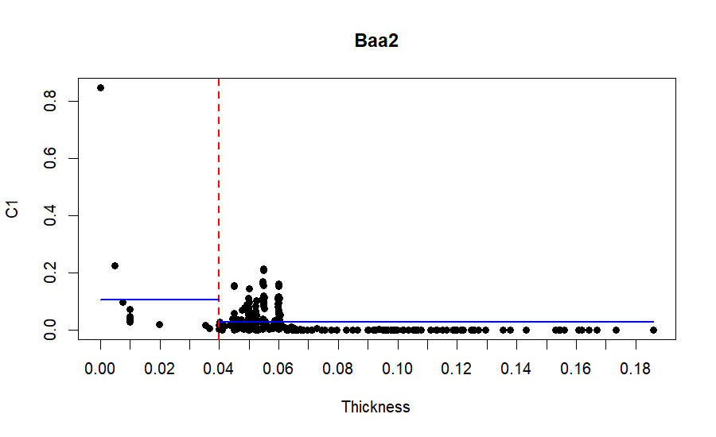
Tranche Thickness 4% Cut-Off
Baa1/Baa2
Raw C-1 Factor
Raw C-1 Factor
The scatterplots above show the relationship between tranche thickness and raw C-1 factor within a single rating bucket. Each dot represents one CLO debt tranche. The blue horizontal lines show the average raw C-1 factor across the dataset for CLO debt tranches of the given rating and tranche thickness (less than or equal vs. greater than 4%). The difference between the blue lines shows that tranche thickness provides information on tail risk, as represented by the raw C-1 factor, that is not captured by ratings.
Tranche thickness is not included as a comparable attribute in modeled factors for Baa1 and Baa2 due to low sample size in these ratings, even though the pattern can be observed here.

Slide 22
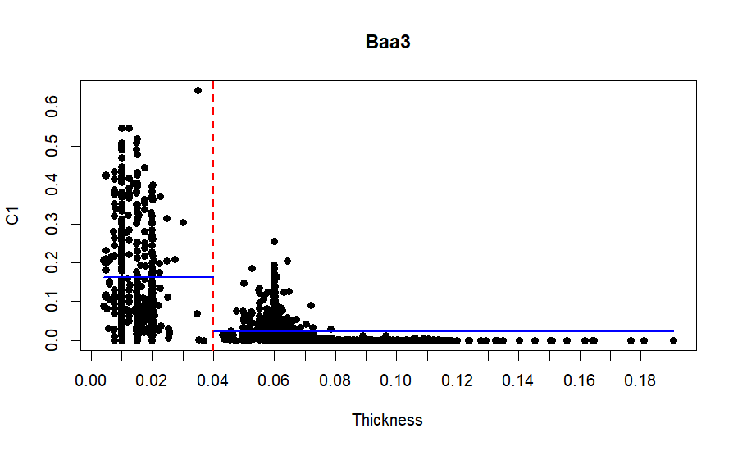
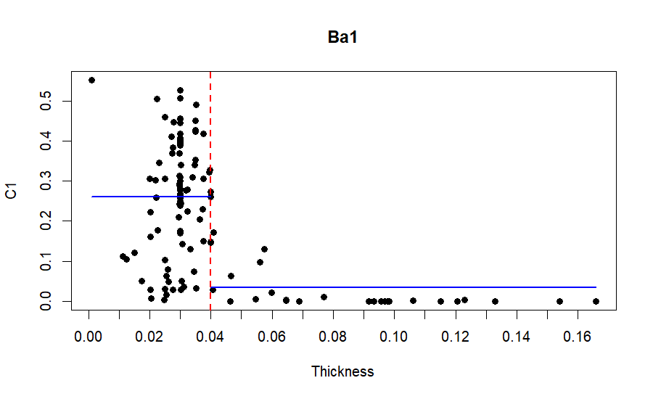
Tranche Thickness 4% Cut-Off
Baa3/Ba1
Raw C-1 Factor
Raw C-1 Factor
The scatterplots above show the relationship between tranche thickness and raw C-1 factor within a single rating bucket. Each dot represents one CLO debt tranche. The blue horizontal lines show the average raw C-1 factor across the dataset for CLO debt tranches of the given rating and tranche thickness (less than or equal vs. greater than 4%). The difference between the blue lines shows that tranche thickness provides information on tail risk, as represented by the raw C-1 factor, that is not captured by ratings.

Slide 23
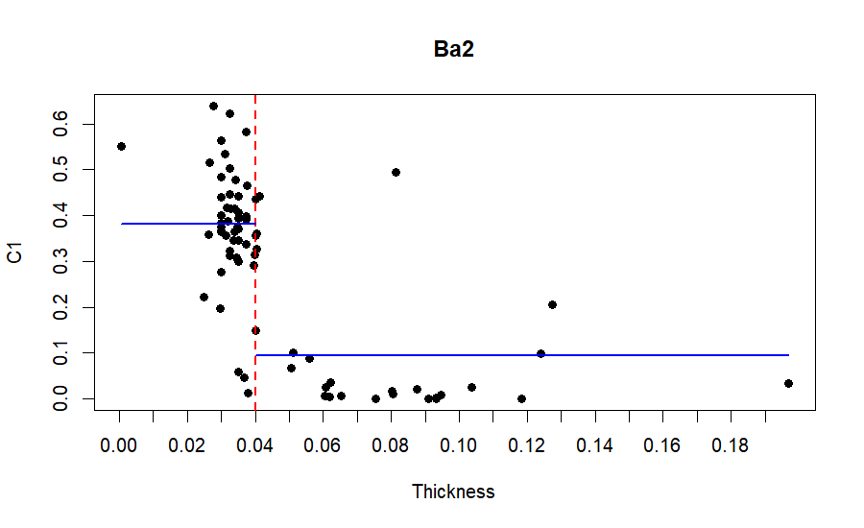
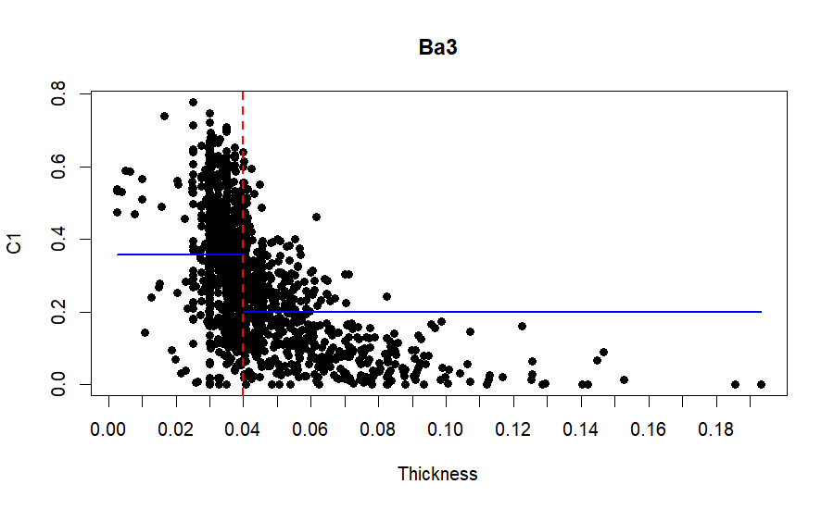
Tranche Thickness 4% Cut-Off
Ba2/Ba3
Raw C-1 Factor
Raw C-1 Factor
The scatterplots above show the relationship between tranche thickness and raw C-1 factor within a single rating bucket. Each dot represents one CLO debt tranche. The blue horizontal lines show the average raw C-1 factor across the dataset for CLO debt tranches of the given rating and tranche thickness (less than or equal vs. greater than 4%). The difference between the blue lines shows that tranche thickness provides information on tail risk, as represented by the raw C-1 factor, that is not captured by ratings.

Slide 24
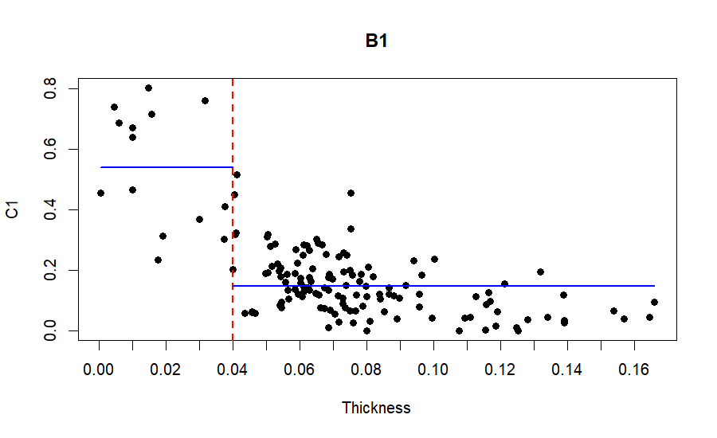
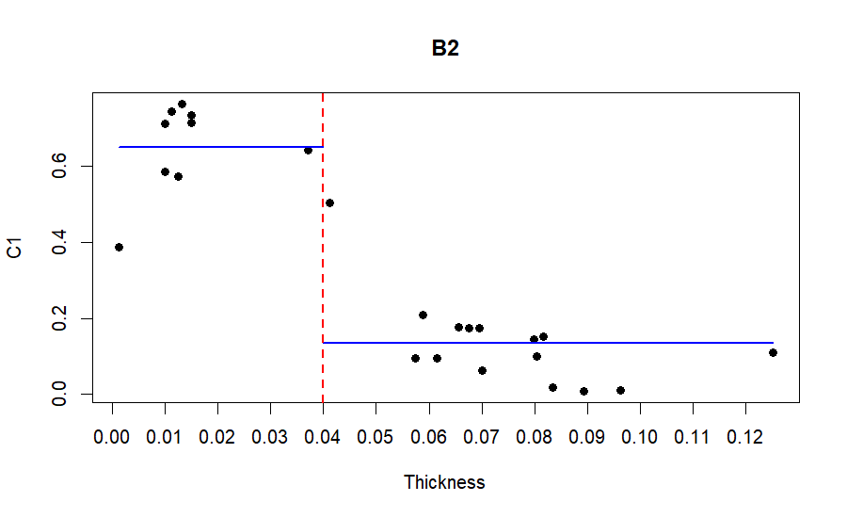
Tranche Thickness 4% Cut-Off
B1/B2
Raw C-1 Factor
Raw C-1 Factor
The scatterplots above show the relationship between tranche thickness and raw C-1 factor within a single rating bucket. Each dot represents one CLO debt tranche. The blue horizontal lines show the average raw C-1 factor across the dataset for CLO debt tranches of the given rating and tranche thickness (less than or equal vs. greater than 4%). The difference between the blue lines shows that tranche thickness provides information on tail risk, as represented by the raw C-1 factor, that is not captured by ratings.

Slide 25
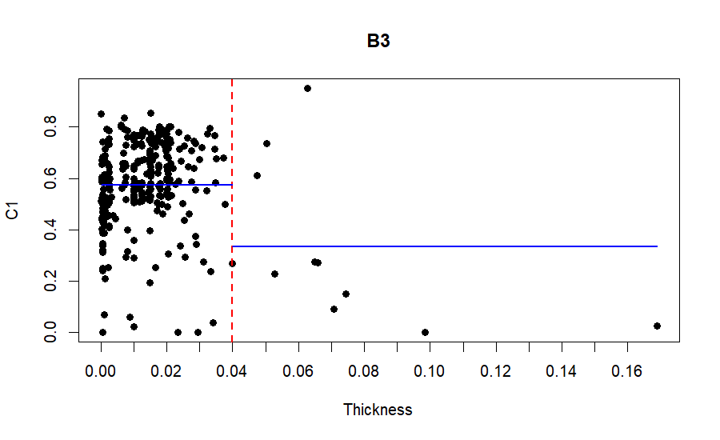
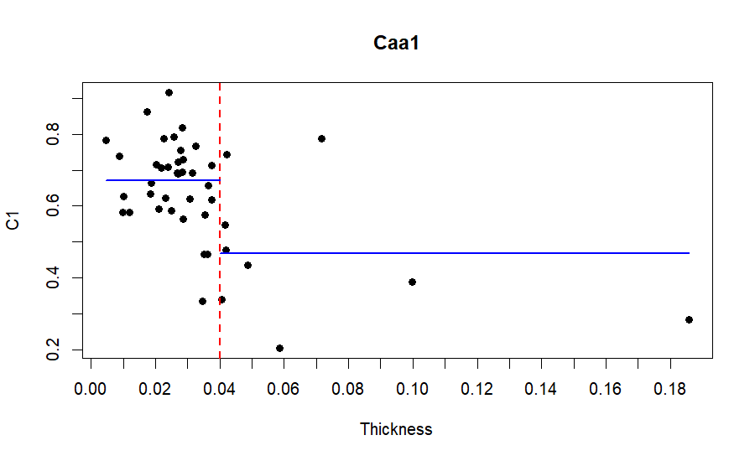
Tranche Thickness 4% Cut-Off
B3/Caa1
Raw C-1 Factor
Raw C-1 Factor
The scatterplots above show the relationship between tranche thickness and raw C-1 factor within a single rating bucket. Each dot represents one CLO debt tranche. The blue horizontal lines show the average raw C-1 factor across the dataset for CLO debt tranches of the given rating and tranche thickness (less than or equal vs. greater than 4%). The difference between the blue lines shows that tranche thickness provides information on tail risk, as represented by the raw C-1 factor, that is not captured by ratings.

Slide 26
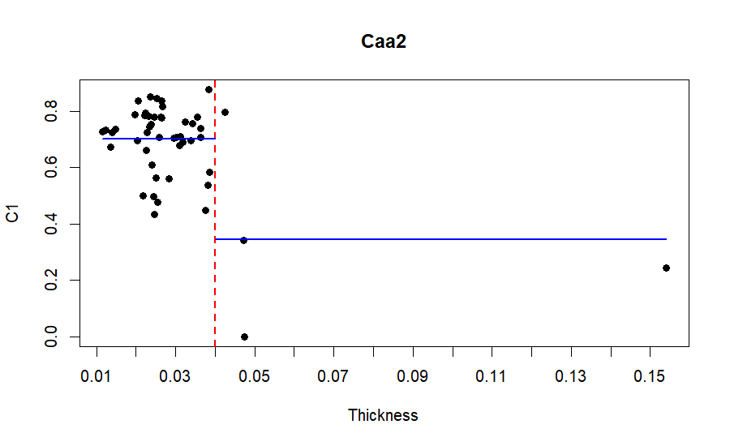
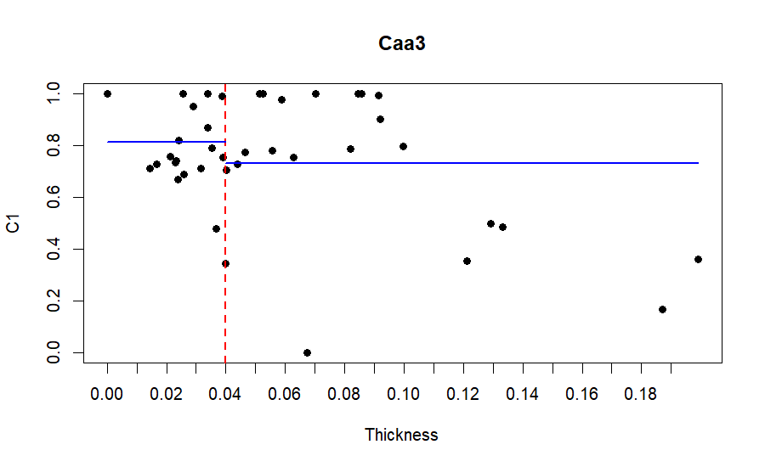
Tranche Thickness 4% Cut-Off
Caa2/Caa3
Raw C-1 Factor
Raw C-1 Factor
The scatterplots above show the relationship between tranche thickness and raw C-1 factor within a single rating bucket. Each dot represents one CLO debt tranche. The blue horizontal lines show the average raw C-1 factor across the dataset for CLO debt tranches of the given rating and tranche thickness (less than or equal vs. greater than 4%). The difference between the blue lines shows that tranche thickness provides information on tail risk, as represented by the raw C-1 factor, that is not captured by ratings.

Slide 27
Distribution by Tranche Thickness
*High vs. low is defined as greater than vs. less than 4%
Differences between Baa2 and Baa3 tranche thickness are driven by securities with smaller $ balances. In other words, the intuitive result holds that thin tranches have smaller $ balances than thick tranches for most ratings.

Slide 28
Distribution by Tranche Thickness
*High vs. low is defined as greater than vs. less than 4%
 | Counts |  | Balance |  | Difference (Balance - Counts)
 | High | Low | High | Low | High | Low
Aaa | 84% | 16% | 99% | 1% | 15% | -15%
Aa1 | 99% | 1% | 99% | 1% | 1% | -1%
Aa2 | 99% | 1% | 100% | 0% | 1% | -1%
Aa3 | 100% | 0% | 100% | 0% | 0% | 0%
A1 | 93% | 7% | 96% | 4% | 3% | -3%
A2 | 98% | 2% | 99% | 1% | 1% | -1%
A3 | 98% | 2% | 98% | 2% | 1% | -1%
Baa1 | 91% | 9% | 95% | 5% | 4% | -4%
Baa2 | 96% | 4% | 98% | 2% | 2% | -2%
Baa3 | 74% | 26% | 93% | 7% | 19% | -19%
Ba1 | 24% | 76% | 34% | 66% | 10% | -10%
Ba2 | 37% | 63% | 47% | 53% | 10% | -10%
Ba3 | 43% | 57% | 52% | 48% | 10% | -10%
B1 | 91% | 9% | 97% | 3% | 6% | -6%
B2 | 65% | 35% | 88% | 12% | 22% | -22%
B3 | 4% | 96% | 10% | 90% | 7% | -7%
Caa1 | 30% | 70% | 47% | 53% | 17% | -17%
Caa2 | 12% | 88% | 17% | 83% | 5% | -5%
Caa3 | 60% | 40% | 73% | 27% | 12% | -12%

Slide 29
Raw C-1 Factor Averages by Tranche Thickness
*High vs. low is defined as greater than vs. less than 4%
Differences between high thickness and low thickness factors do not trend across rating and only have minor improvements to model fit; we use one premium across all ratings to avoid overfitting

Slide 30
Model* Output Thickness Premiums
*Applying regression to standardize reinvestment horizon to mean, spiking out 4% thickness for Baa3/below and applying isotonic regression to A2/above
After accounting for reinvestment horizon (see next section) and estimating the thickness premium at each rating, we observe noisy results for B1/below and elect to use a single average across all Baa3/below ratings

Slide 31
Tranche Thickness and Reinvestment Horizon
Within Baa3 tranches, two distinct groups are represented here by two horizontal lines of bubbles.
Each bubble represents one CLO debt tranche, with larger bubbles having higher C-1 factors.
Bubbles are larger in the bottom row, showing that thin tranches are riskier.
Bubbles are larger on the right, showing that longer remaining reinvestment horizons have more modeled risk.

Slide 32
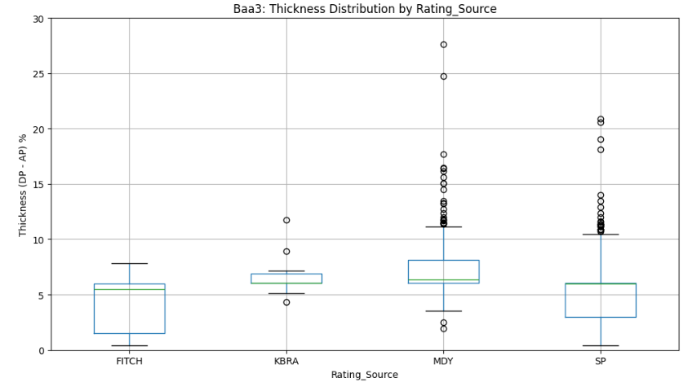
Tranche Thickness by Rating Agency
Thinner tranches can qualify for an investment-grade rating from S&P or Fitch, which rate to the first dollar of loss (attachment point drives rating, detachment point does not).
Moody’s and KBRA* ratings incorporate severity of loss, as do modeled C-1 factors, and thus higher detachment points tend to be required for an investment-grade rating from Moody’s or KBRA*.
*KBRA is drawn from a smaller sample size in the data-set, consisting of only 10 Baa3 CLOs (see following slide for further details on the dataset)

Slide 33
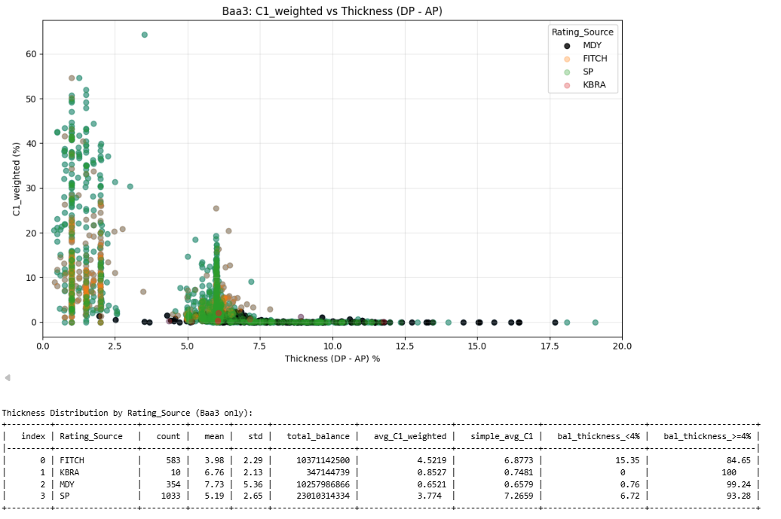
Tranche Thickness by Rating Agency
Baa3 CLOs are clustered at a 6% thickness (typical Baa3 attaches at 12% and detaches at 18%).
Moody’s ratings (black dots) tend to have higher thickness than S&P ratings (green dots).

Slide 34
Reinvestment Horizon
Adjusting reinvestment horizon to mean fixes non-monotonicity in average C-1 factors, among below investment grade ratings.
 | High Thickness |  | Low Thickness
Rating | Simple Average | Constant Reinvestment Horizon | Simple Average | Constant Reinvestment Horizon
Aaa | 0.03% | 0.03%
Aa1 | 0.28% | 0.27%
Aa2 | 0.00% | 0.00%
Aa3 | 0.00% | 0.04%
A1 | 0.40% | 0.41%
A2 | 0.11% | 0.10%
A3 | 0.12% | 1.45%
Baa1 | 1.58% | 1.81%
Baa2 | 3.02% | 2.70%
Baa3 | 5.94% | 2.73% | 16.27% | 12.52%
Ba1 | 20.70% | 12.59% | 26.09% | 22.39%
Ba2 | 27.37% | 20.93% | 38.13% | 30.72%
Ba3 | 28.92% | 23.28% | 35.61% | 33.08%
B1 | 17.34% | 26.04% | 53.96% | 35.84%
B2 | 30.81% | 35.20% | 65.04% | 44.99%
B3 | 56.39% | 47.32% | 57.35% | 57.12%
Caa1 | 57.60% | 48.12% | 67.07% | 57.92%
Caa2 | 66.51% | 55.20% | 70.16% | 64.99%
Caa3 | 77.33% | 70.82% | 81.47% | 80.61%

Slide 35
Reinvestment Horizon
*The effect of reinvestment horizon on C-1 is not homogenous across ratings. Due to data limitations (total observations and variance in C-1), not all ratings are credible enough to have their own interaction term; buckets were chosen to optimize adjusted R².
Ratings with short reinvestment horizons have suppressed average C-1 factors
To estimate this effect, we regress C-1 against reinvestment horizon, with interactions to the following buckets*:
Bucket 1: Aaa
Bucket 2: Aa1, Aa2
Bucket 3: Aa3, A1, A2
Bucket 4: A3, Baa1, Baa2
Bucket 5: Baa3, Ba1, Ba2
Bucket 6: Ba3, B1, B2
Bucket 7: B3, Caa1, Caa2, Caa3

Slide 36
Reinvestment Horizon—High Thickness Factors

Slide 37
Reinvestment Horizon—Low Thickness Factors

Slide 38
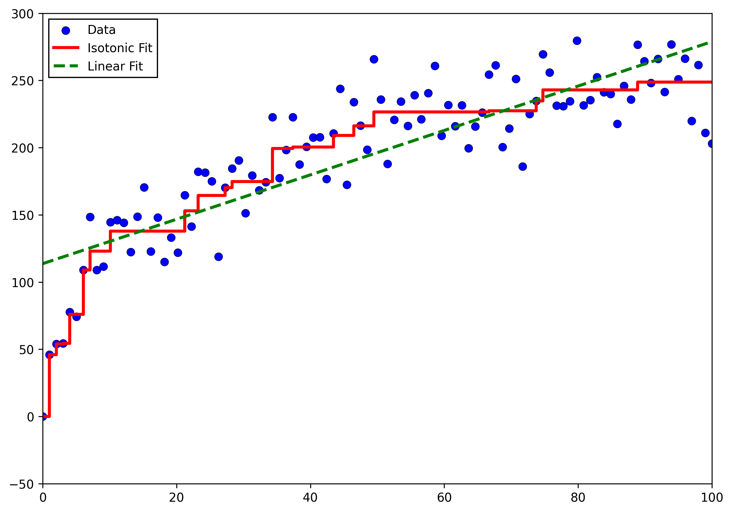
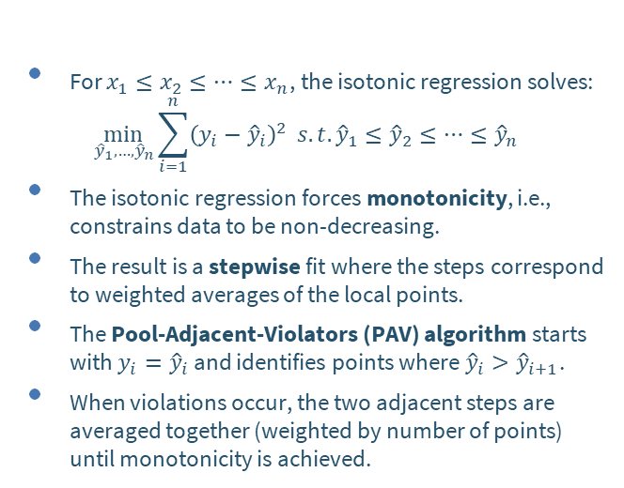
Isotonic Regression
For $x_{1}≤x_{2}≤…≤x_{n}$, the isotonic regression solves:
$$\min_{{\hat{y}}_{1}, …,{\hat{y}}_{n}}{\sum_{i=1}^{n}{{\left(y_{i}−{\hat{y}}_{i}\right)}^{2}}} s.t. {\hat{y}}_{1}≤{\hat{y}}_{2}≤…≤{\hat{y}}_{n}$$
The isotonic regression forces monotonicity, i.e., constrains data to be non-decreasing.
The result is a stepwise fit where the steps correspond to weighted averages of the local points.
The Pool-Adjacent-Violators (PAV) algorithm starts with $y_{i}={\hat{y}}_{i}$ and identifies points where ${\hat{y}}_{i}>{\hat{y}}_{i+1}$.
When violations occur, the two adjacent steps are averaged together (weighted by number of points) until monotonicity is achieved.
Illustrative Data:

Slide 39
Isotonic Regression—Applied to A3/above CLO C-1 Factors
Average C-1 factors are not monotonic across rating for Aa1 to A2.
The frequency for non-zero C-1 factors is too low for factors to be credible for Aa1 to A2.
Isotonic regression smooths the average C-1s.
 | Total Observations | Non-Zero C-1 Observations | Average C-1 Factors | Isotonic C-1 Factors
Aaa | 3,701 | 2 | 0.03% | 0.03%
Aa1 | 297 | 1 | 0.27% | 0.04%
Aa2 | 1,879 | 1 | 0.00% | 0.04%
Aa3 | 68 | 0 | 0.04% | 0.04%
A1 | 246 | 73 | 0.41% | 0.14%
A2 | 1,642 | 844 | 0.10% | 0.14%
A3 | 41 | 5 | 1.45% | 1.45%

Slide 40
Equal-Weighted (Simple) vs. Balance-Weighted Raw C-1
All Tranches
Average C-1 factors tend to be lower when weighting by current balance, as opposed to simple average
This gap is driven by correlation between balance and tranche thickness—it dissipates when accounting for thickness and reinvestment horizon (see next page)
Because weighted regressions have fewer effective degrees of freedom, we present unweighted results
Rating | Counts | Non-Zero C-1 Counts | Simple Average | Weighted Average | Diff
Aaa | 3,701 | 2 | 0.03% | 0.01% | -0.02%
Aa1 | 297 | 1 | 0.28% | 0.31% | 0.03%
Aa2 | 1,879 | 1 | 0.00% | 0.00% | 0.00%
Aa3 | 68 | - | 0.00% | 0.00% | 0.00%
A1 | 246 | 73 | 0.40% | 0.38% | -0.02%
A2 | 1,642 | 844 | 0.11% | 0.10% | -0.01%
A3 | 41 | 5 | 0.12% | 0.13% | 0.01%
Baa1 | 168 | 120 | 1.58% | 1.33% | -0.24%
Baa2 | 356 | 286 | 3.02% | 2.56% | -0.46%
Baa3 | 1,980 | 1,824 | 5.94% | 3.20% | -2.74%
Ba1 | 118 | 107 | 20.70% | 19.21% | -1.50%
Ba2 | 79 | 75 | 27.37% | 23.67% | -3.70%
Ba3 | 1642 | 1621 | 28.92% | 26.65% | -2.27%
B1 | 154 | 146 | 17.34% | 15.46% | -1.89%
B2 | 26 | 25 | 30.81% | 18.70% | -12.10%
B3 | 330 | 326 | 56.39% | 57.38% | 0.99%
Caa1 | 50 | 50 | 57.60% | 49.49% | -8.10%
Caa2 | 51 | 50 | 66.51% | 65.78% | -0.73%
Caa3 | 58 | 57 | 77.33% | 70.71% | -6.62%

Slide 41
Unweighted vs. Weighted Modeled* C-1 Factors
*Applying regression to standardize reinvestment horizon to mean, spiking out 4% thickness for Baa3/below and applying isotonic regression to A2/above
Tranche Thickness > 4%
Tranche Thickness <= 4%
Rating | Counts | Non-Zero C-1 Counts | Unweighted | Weighted | Diff
Aaa | 3,701 | 2 | 0.03% | 0.01% | -0.02%
Aa1 | 297 | 1 | 0.04% | 0.04% | 0.00%
Aa2 | 1,879 | 1 | 0.04% | 0.04% | 0.00%
Aa3 | 68 | - | 0.04% | 0.04% | 0.00%
A1 | 246 | 73 | 0.14% | 0.14% | -0.01%
A2 | 1,642 | 844 | 0.14% | 0.14% | -0.01%
A3 | 41 | 5 | 1.45% | 1.39% | -0.06%
Baa1 | 168 | 120 | 1.81% | 1.70% | -0.11%
Baa2 | 356 | 286 | 2.70% | 2.44% | -0.26%
Baa3 | 1,468 | 1,322 | 2.73% | 2.68% | -0.05%
Ba1 | 28 | 17 | 12.59% | 13.09% | 0.49%
Ba2 | 29 | 25 | 20.93% | 19.23% | -1.70%
Ba3 | 698 | 682 | 23.28% | 23.57% | 0.29%
B1 | 140 | 132 | 26.04% | 25.48% | -0.56%
B2 | 17 | 16 | 35.20% | 27.25% | -7.95%
B3 | 12 | 11 | 47.32% | 48.53% | 1.21%
Caa1 | 15 | 15 | 48.12% | 48.53% | 0.41%
Caa2 | 6 | 5 | 55.20% | 57.99% | 2.79%
Caa3 | 35 | 34 | 70.82% | 68.02% | -2.80%
Rating | Counts | Non-Zero C-1 Counts | Unweighted | Weighted | Diff
Aaa | 3,701 | 2 | 0.03% | 0.01% | -0.02%
Aa1 | 297 | 1 | 0.04% | 0.04% | 0.00%
Aa2 | 1,879 | 1 | 0.04% | 0.04% | 0.00%
Aa3 | 68 | - | 0.04% | 0.04% | 0.00%
A1 | 246 | 73 | 0.14% | 0.14% | -0.01%
A2 | 1,642 | 844 | 0.14% | 0.14% | -0.01%
A3 | 41 | 5 | 1.45% | 1.39% | -0.06%
Baa1 | 168 | 120 | 1.81% | 1.70% | -0.11%
Baa2 | 356 | 286 | 2.70% | 2.44% | -0.26%
Baa3 | 512 | 502 | 12.52% | 11.79% | -0.73%
Ba1 | 90 | 90 | 22.39% | 22.20% | -0.19%
Ba2 | 50 | 50 | 30.72% | 28.34% | -2.38%
Ba3 | 944 | 939 | 33.08% | 32.69% | -0.39%
B1 | 14 | 14 | 35.84% | 34.59% | -1.24%
B2 | 9 | 9 | 44.99% | 36.36% | -8.64%
B3 | 318 | 315 | 57.12% | 57.65% | 0.53%
Caa1 | 35 | 35 | 57.92% | 57.65% | -0.27%
Caa2 | 45 | 45 | 64.99% | 67.10% | 2.11%
Caa3 | 23 | 23 | 80.61% | 77.13% | -3.48%

Slide 42
Appendix 3—Alternative Models Considered

Slide 43
Tested Regressions—Part 1
Regression Exogenous Variables | Adjusted R² | Number of Parameters | Notes
All Variables, excluding Rating (no transformations) | 42.6% | 47 | Baseline estimate for non-rating characteristics
Attachment Point Percentile Buckets (50 equal-sized) | 66.5% | 50
Thickness (DP – AP) Percentile Buckets (50 equal-sized) | 45.3% | 50
Detachment Point Percentile Buckets (50 equal-sized) | 76.5% | 50 | New baseline for non-rating characteristics. Downside: agnostic towards underlying credit quality.
Rating | 74.2% | 19 | Baseline for ratings. Explanatory power comparable to detachment point
Rating + Detachment Point | 74.4% | 20 | Adds little additional explanatory power over rating
Rating modeled as individual indicator variables for each of the 19 ratings

Slide 44
Tested Regressions—Part 2
Regression Exogenous Variables | Adjusted R² | Number of Parameters | Notes
Rating + Detachment Point Buckets | 81.8% | 68 | Explains an additional 7.6% of variance over ratings only
Rating + Reinvestment Horizon | 76.2% | 20 | Reinvestment horizon explains an additional 2.0% of variance over ratings only; is the most explanatory variable when added to rating (w/o transformation)
Rating + Reinvestment Horizon x Rating (interaction terms with rating) | 82.4% | 37 | Explains an additional 8.2% of variance over ratings only; potential overfitting on thin tranches
Rating + Reinvestment Horizon x Rating Letter (interactions with AAA, AA, A, etc.) | 81.6% | 26 | Loses less than 1% of variance explained Adds credibility to non-standard tranches
Rating + Reinvestment Horizon x Rating Bucket (interactions with B3/below, B2/B1/Ba3, Ba1/Ba2/B3, etc.) | 81.6% | 26 | Comparable R² as rating letter; adds credibility to CCC (adds observations and adds variance in horizon)
Rating + Reinvestment Horizon x Rating Bucket + Detachment Point | 81.7% | 27 | Negligible improvement over model without DP
Rating modeled as individual indicator variables for each of the 19 ratings

Slide 45
Tested Regressions—Part 3
Regression Exogenous Variables | Adjusted R² | Number of Parameters | Notes
Rating + Reinvestment Horizon x Rating Bucket + Detachment Point Buckets | 85.6% | 75 | Detachment point (at the granular level) explains an additional 4.0% of variance
Rating + Reinvestment Horizon x Rating Bucket + Thickness | 81.7% | 27 | Negligible improvement over model without thickness
Rating + Reinvestment Horizon x Rating Bucket + Flag for [Thickness ≤ 4% & Baa3/below Rating] | 83.2% | 27 | Explains additional 1.6% of variance over model without thickness or DP; chosen model
Rating + Reinvestment Horizon x Rating Bucket + Flag for [Thickness ≤ 4% & Baa3/below Rating] * Rating | 84.3% | 36 | Explains only 1% additional variance with 9 additional variables; potential overfitting for below-IG
Rating + Reinvestment Horizon x Rating Bucket + Flag for [Thickness ≤ 4% & Baa3/below Rating] + Detachment Point Buckets | 85.7% | 76 | Reference point: granular detachment point data only explains an additional 2.5% of variance over chosen model
Rating modeled as individual indicator variables for each of the 19 ratings

Slide 46
References
American Academy of Actuaries (2025, Sept 8). C-1 Subcommittee Update on CLO-C1 Factors Modeling [Slides]. NAIC RBC IRE Public Call.
American Academy of Actuaries (2025, Dec 15). C-1 Subcommittee Update on CLO-C1 Factors Modeling [Slides]. NAIC RBC IRE Public Call.
S&P, “Default, Transition, and Recovery: Recovery Study (U.S.): Quantitative Easing, Low Yields, And Distressed Exchanges Have Boosted Bond Recoveries Since 2010,” December 14, 2017.

Slide 47
Questions?
For more information, please contact
Amanda Barry-Moilanen,
the Academy’s Policy Project Manager, Life at barrymoilanen@actuary.org

