Slide 1

SERFF Product Steering Committee
March 31, 2026
Meeting Recording:
https://naic.webex.com/naic/ldr.php?RCID=dcd474900fe83fdddf8035b9ae6fcb06

Slide 2
Member Attendance
• Attendance was verified against the meeting participant list
• Interested parties who called in via phone and wish their attendance to be recorded can email adysart@naic.org

Slide 3

Agenda
General Updates
Reflecting on First Year
2026 Roadmap
CLARA
Open Q&A

Slide 4
General Updates

Slide 5

SERFF Login Transition to Okta
Legacy SERFF credentials are being phased out – within the next two weeks!!!
Direct emails are being sent to users who are not currently logging in via Okta, to help them prepare for the transition.
All users should log in using Okta whenever possible, as it will be the standard authentication method going forward.

Slide 6
Checking Your Okta Access
Go to https://authenticate.naic.org
Username: Try your Legacy username. If that doesn’t work, try your email address.
Password: It may be different from your Legacy password.
  If you don’t know it, click Forgot Password.
  Check your email for the password reset message.
Important
If there are too many unsuccessful login attempts, your Okta account will temporarily lock.
  This does not affect your Legacy access at this time.
  If a lock occurs, the service desk can help resolve it.
If you’re unable to log in for any reason, please contact help@naic.org!
Please be patient with the support teams, as volume is high.

Slide 7
Events
AICP at the NAIC
  April 7 in Kansas City
  SERFF Presentation: 11:00am–11:45am
LHCA
  April 14-16 in San Antonio
  SERFF Presentation: Thursday, April 16th from 10:00am-11:30am

Slide 8
SERFF Education & Training
SERFF Legacy Training – Industry
  April 7 – 9
  Sign up at naic.compass.org
SERFF Legacy Training – Regulator
  Scheduled by Request, e-mail education@naic.org
SERFF Modernization Training for Industry Compact Filers
  Next session April 14, 2026 (EDU300-186)

Slide 9
National Meeting Presentation Repeat

Slide 10

Reflecting on First Year

Slide 11
Release 1 Wins
Smooth Rollout and Migration
Introduction of New Features and Capabilities
Superior Customer Service

Slide 12
New Features & Capabilities
  Modern interface
  Streamlined wizard for filing creation
  License verification against NAIC data
  Form Schedule AI
  Consolidation of methods for filing modification
  Robust document comparison and annotation capabilities
  Enhanced review features
  Task based approach for "to do" items
  Email notifications
  Tailored Disposition & Public Access flow
  Enhanced state business rule and configuration options
  Customized flow for Compact Registration
  Self-service user management
  AI Help Module

Slide 13
Challenges
Feature Gaps
Managing Change
Performance

Slide 14
How We Are Responding
Extensive industry user engagement
Close collaboration with Compact
Ongoing focus on quality, performance, and usability
Expansion of partnerships

Slide 15
2026 Roadmap

Slide 16
2026 Roadmap
Q1
Q2
Q3
Q4
Ongoing Development
Early Adopter Preparation
Early Adopters Moving to Production
Cohort 2 Selection
Cohort 2 Preparation
Plan Mngmt Requirements

Slide 17
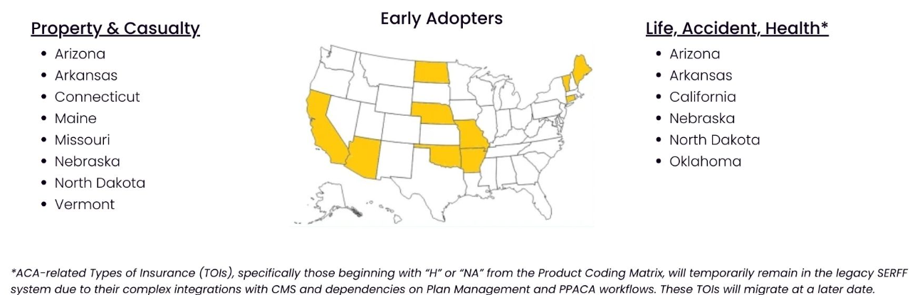
Early Adopter States

Slide 18
Co-Existence & Transition Timelines
EA states may have different transition dates
Many users will operate in both systems for a time
Both systems will have messaging and tools to help guide users
Early adopters will inform next steps and the longer-term roadmap

Slide 19
Training & Transition
States undergo hands-on, immersive training
Partial hands on training for companies, supplemented with videos and written documentation
A 30-day notice will be given prior to state cutover
Extensive outreach occurring through multitude of channels
Project email: serffmodernizationquestions@naic.org

Slide 20
CLARA
Compliance Language Assistant for Regulatory Analysis

Slide 21
Behind the Curtain
CLARA...
leverages advanced NLP techniques to interpret insurance form language and compare it against regulatory standards.
was built by NAIC resources using AWS components and machine learning models.
is entirely within NAIC’s infrastructure.
is secured by the NAIC single sign on tenant, OKTA.
is currently a lightweight, stand-alone application.

Slide 22
Training & Using CLARA for Review
Training CLARA
  Identify a rule and explain it to CLARA.
  Provide examples of compliant and non-compliant language.
  The complexity of the rule impacts the number of examples needed.
  Test the rule with additional examples.
  Refine as needed.
Using CLARA
  Rules are combined into rule sets.​
  PDFs are uploaded against a rule or rule set.​
  CLARA provides pass/fail results for each rule, with basis for recommendation.​
  Human user reviews and take actions.​

Slide 23
CLARA Pilot & 2026 Roadmap
CLARA Pilot
  Pilot states: Arizona, Connecticut, Vermont, and the Insurance Compact
  New to the program: Arkansas and the District of Columbia
  Discussions ongoing with additional states
CLARA 2026 Roadmap
  Continue and expand pilot
  Make usability, performance, and scaling improvements
  Implement feedback loop
  Expand support for different types of rules
  Transition from manual interactions to SERFF Integrations

Slide 24
Open Q&A
(Menti)

Slide 25
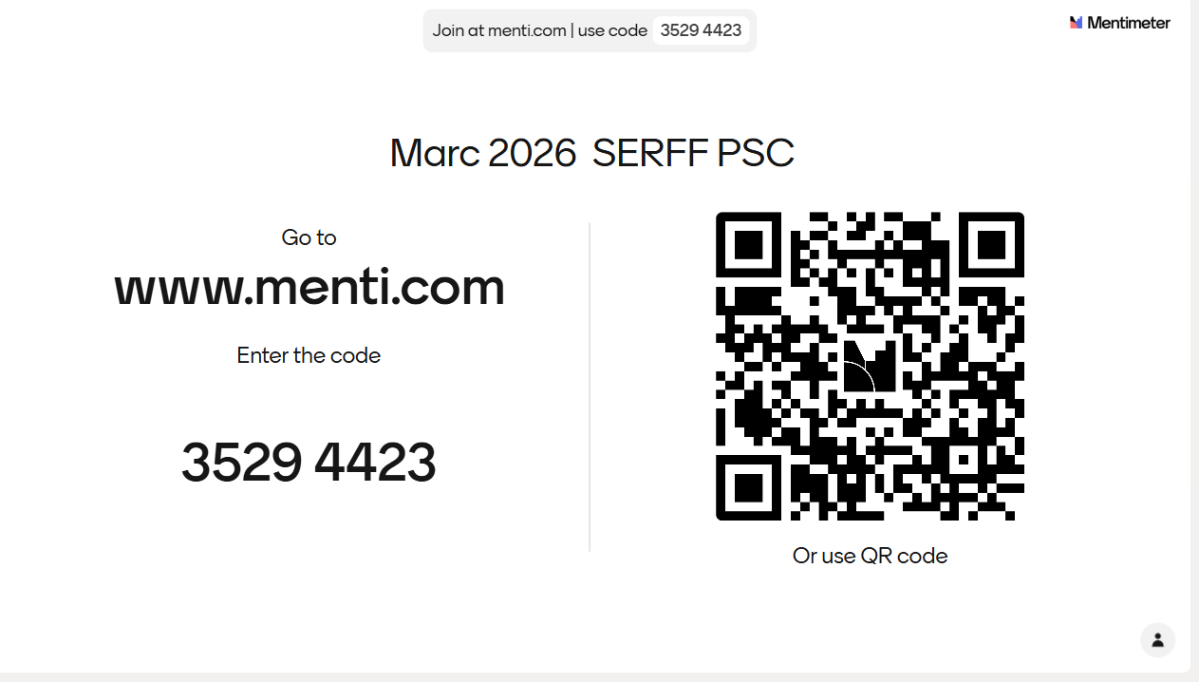

Slide 26
2026 Meeting Dates
April 22
May 27
June 24
July 22
August 26
September 23
October 28
November 18
December 16

Slide 27
Thank You

