Slide 1

SERFF Product Steering Committee
July 22, 2026
Meeting Recording:
https://naic.webex.com/naic/ldr.php?RCID=d22c5e6878b2c8a5f0a3bc4304b38400

Slide 2
We will begin shortly

Slide 3
Attendance
Attendance was verified against the meeting participant list​​
​
Interested parties who called in via phone and wish their attendance to be recorded can email adysart@naic.org

Slide 4

Agenda
SERFF Legacy Update
SERFF Modernization Update
Engagement Activity
Q&A

Slide 5
SERFF Legacy Update

Slide 6
Legacy File Upload Naming Changes
Multi-file upload (up to 50 files at once) was a top-requested feature — now available for all filing types
The development team re-used similar functionality to expedite this development
The team also had a goal to reduce support issues related to file handling in browsers and PDF Pipeline
Dashes, periods, and underscores are supported
Reverting naming rules would require removing multi-file upload

Slide 7
SERFF Modernization Update

Slide 8
Adoption Timeline
WE ARE HERE
▼
2024 - 2025
Late 2026 - Early 2027
2027
TBD
TBD
Compact
Early Adopters
Cohort 2
Remaining States
Plan Mgmt
Innovators
10 States
Next Wave
Bulk Migration
H & NA TOIs
Platform validation
with Insurance Compact
Staggered rollout
for selected state instances
Selection in process
May include additional instances from EA states
Likely larger than EA phase
All workload in new system except H and NA TOIs and Plan Management
Final transition and retirement of Legacy SERFF
COMPLETE
IN PROGRESS
UPCOMING
FUTURE
PLANNING

Slide 9
Early Adopter Implementations
Expected implementation activity for Early Adopter states through year-end
September
Q4 · October–December
First state cutover expected
4–5 additional states expected
One Early Adopter state expected to go live in late September
Cutovers staggered by state, each with 30 days’ advance notice
Transitioned states file in new SERFF; legacy filings become read-only
Industry testing cycles continue ahead of each go-live
4–5 additional Early Adopter states transition on a rolling schedule
H & NA TOIs remain in legacy SERFF pending Plan Management
Training and support resources support available throughout
LATE SEPTEMBER 2026
OCT – DEC 2026

Slide 10

Announcing Our First State
FIRST STATE TO GO LIVE
Arizona
Arizona is expected to be the first state to go live on the new platform, with a launch date in late September.

Slide 11
What Filers Need to Know
During the Transition
You may file in both legacy and new SERFF until all states fully transition
Historical filings migrate; legacy version becomes read-only
Draft filings do not migrate
Submit before cutover or recreate in new system
30 days’ advance notice before each state’s cutover date
Training & Support
Training sessions, videos, and written documentation
Enterprise Copilot for in-platform guided assistance
Stay Informed:
SERFF notifications/alerts and targeted emails for cutover updates

Slide 12
NAIC Compass – New Industry Training Available
'SERFF Modernization Training for Insurance Industry Professionals: Filers to Early Adopter States'
    Covers navigation, task management, filing creation and submission, and the workflow for updating filings in SERFF Modernization
    Continuing Education (CE) credit available for eligible participants
    Multiple course offerings available July 31 – September 3
    Separate training remains available for Legacy SERFF
    More details at compass.naic.org

Slide 13
Cohort 2 States
Preliminary State Participation List
12
Connecticut (LAC)
Idaho
Louisiana
Massachusetts
Minnesota
Nevada
New Hampshire
Rhode Island
South Carolina
Texas
Virginia
Wyoming
states currently listed
Preliminary Cohort 2 participation list
Note: Several states are pending confirmation and may be added to this list. Scope of transition may vary by state.

Slide 14

Invitation – Industry Testers
We're looking for filers willing to test on the new platform
Participation involves hands-on testing in a non-production environment and providing feedback
This is an ongoing commitment — expect multiple testing cycles over the next 4 months
Ideal candidates are actively filing in SERFF today and can dedicate time when testing windows open
We're prioritizing participants who can commit to at least 4-6 hours per week, for a minimum of three consecutive weeks
Interested? Email Serffmodernizationquestions@naic.org

Slide 15
How Our Team Improves the Application
OPERATING MODEL
How we decide what to work on, then design, build, test, and release improvements that strengthen the application.
Planning cadence: from priorities to releases
How work gets prioritized
QUARTERLY
Feedback from users helps shape priorities — balanced through common filters.
Set priorities
Sets priorities from program goals, user feedback, quality needs, and technical dependencies.
User impact, timing, and urgency
WORK CYCLES
Must / Should / Could tradeoffs
Break priorities into smaller work
MVP and Day 1 scope decisions
Turns priorities into manageable pieces the team can design, build, test, and release.
Consistency across the application
DELIVERY
Platform stability and supportability
Builds and hot fixes
Frequent builds support continuous delivery.
Feature flags help manage rollout safely
Operating principle: the team brings technical expertise; industry, state, and user feedback provides business context so we can increase feature richness and quality while keeping a uniform, stable experience.

Slide 16
Q3 Work: Application Improvements and Quality
Q3 WORK
Focused improvements that make the platform faster, more complete, and higher quality for all users.
Improving the application users rely on every day
Preparing the platform to scale
01
Faster high-use experiences
Richer, higher-quality features
Targeted performance work on the pages and actions filers use most.
02
Maturing amendments
Core workflows, public access portals, and configuration patterns are being readied for broader use.
Completing and polishing the full lifecycle for core filing workflows.
03
Industry & state feedback
Improve
Validate
Scale
Input from industry and state users is reviewed, prioritized, and built into ongoing improvements.
Q3 focus: improve the experience users feel every day while strengthening application quality and readiness for broader use.

Slide 17
Draft Filing Deletion: Q4 Intent
Q4 INTENT
Intent: address deleted draft filing cleanup by adding a recovery window and automated permanent removal.
Why this matters
Q4 feature direction
432
Total deleted draft filings currently in system (out of 619 drafts)
Move deleted drafts out of limbo with two related capabilities:
1
Undelete draft filing
2
Automatic permanent removal
Restore within the retention period; Draft if valid, Ineligible if configuration has drifted.
Start a 90-day retention clock at delete; a daily system job purges after the window closes.
Clutter grows indefinitely
Deleted drafts remain visible by default and accumulate system-wide.
No recovery path
User experience
Deleted filings display their scheduled permanent deletion date. Users can undelete during the 90-day window; after purge, recovery is no longer available.
Accidental deletes cannot be restored to Draft today.
No true removal
Obsolete drafts remain in the system without a purge mechanism.
Expected user impact: less draft-list clutter, a clear recovery path for mistakes, and self-limiting deleted filing visibility.

Slide 18
Q4 Feature: Correcting Filing Classification
Q4 INTENT
User intent: help filers correct filing type or category mistakes without restarting or increasing disapproval risk.
What happens today
Q4 direction: guided correction
2
Because these changes touch related filing requirements, we’ll start with a careful first release:
paths create extra work
1
Before submission
2
After submission
Before submission: start over
Edit the filing category instead of starting over.
Request a reviewed correction to reduce disapproval risk.
Users often need to recreate the filing.
After submission: disapproval risk
Complex changes
Changing a filing category can affect documents, fees, and review expectations. In the first release, users will be guided to manually check and correct some related items.
Correction can delay review and increase disapproval risk.
Expected user impact: fewer restarted filings, clearer correction options, and safer rollout of a complex change.

Slide 19
Engagement Activity

Slide 20
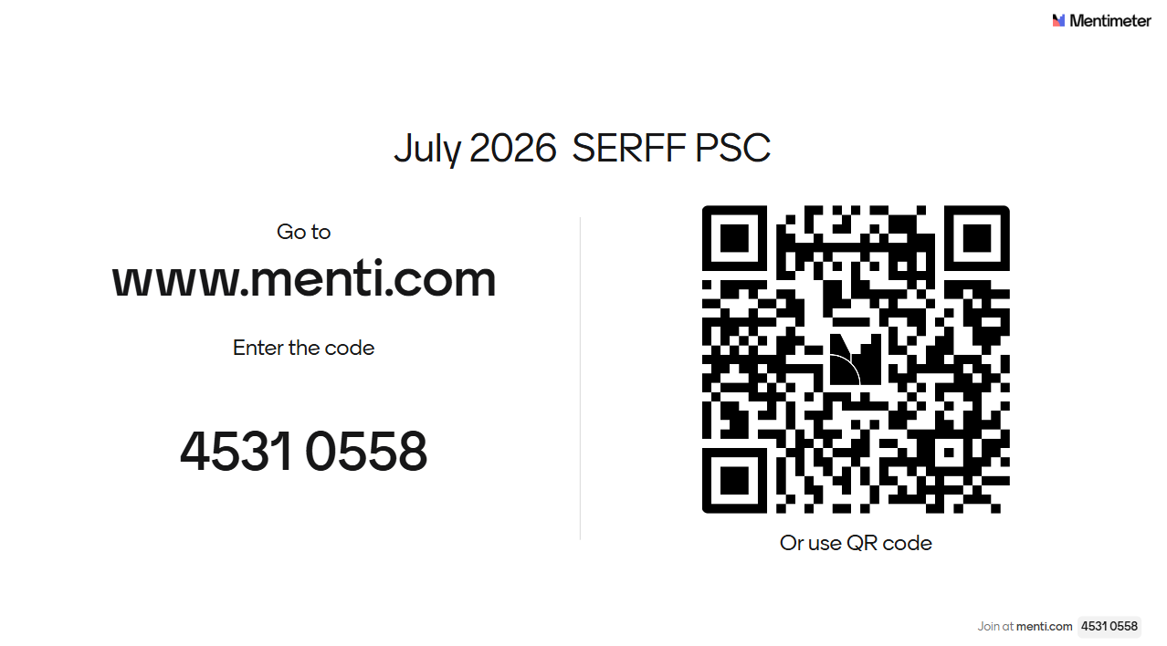

Slide 21
2026 Meeting Dates
August 26
September 23
October 28
November 18
December 16

Slide 22
Thank You

