Slide 1

SERFF Product Steering Committee
August 26, 2026
Meeting Recording:
https://naic.webex.com/naic/ldr.php?RCID=6c5e3572eac382f8677838b98fd1f14e

Slide 2
We will begin shortly

Slide 3
Attendance
Attendance will be verified against the meeting participant list​​
​
Interested parties who called in via phone and wish their attendance to be recorded can email adysart@naic.org

Slide 4
Implementation Update

Slide 5
Pivot to an Early Adopter Model
Where We Started
The Early Adopter Model
Original plan – migrate all Life, Annuity, and Credit workflows in a single release following the Compact.
Sequenced by business type – the rollout followed business type groupings rather than what was ready to use.
Key lesson – moving every state at once carries too much risk – change management, state-specific rules, and complex migration need a more deliberate approach.
Ten early adopter states – selected against technical and engagement criteria to move first.
White glove support – focused help for regulators and filers through every step of the move.
Rapid feedback loops – early use refines the platform before broader rollout, and speed increases as migration and launch processes mature.
Our goal – move states iteratively to help drive change and innovation in SERFF, manage risk carefully, and keep support and resources strong as we scale.

Slide 6
Why Cohort 2
Why a Second Cohort
What It Means for States and Industry
The model is working – early adopters showed that moving iteratively is the right approach.
Widen the circle deliberately – Cohort 2 grows the number of states without a mass migration.
More perspectives, better platform – a broader mix of state rules and workflows surfaces what still needs attention.
Steady, sustainable pace – momentum continues while our support and processes scale with it.
Regulators join a proven path – Cohort 2 states move with the early adopters’ lessons already built into the platform.
A smoother onboarding – training materials, migration steps, and support are far more mature than a year ago.
Consistency for filers – as more states move, industry works in one modern system.
Feedback still shapes the build – state and filer input in this phase still changes what gets built.
Where Cohort 2 sits – the early adopters proved the model, Cohort 2 scales it, and every state and filer that follows benefits from the work done together.

Slide 7
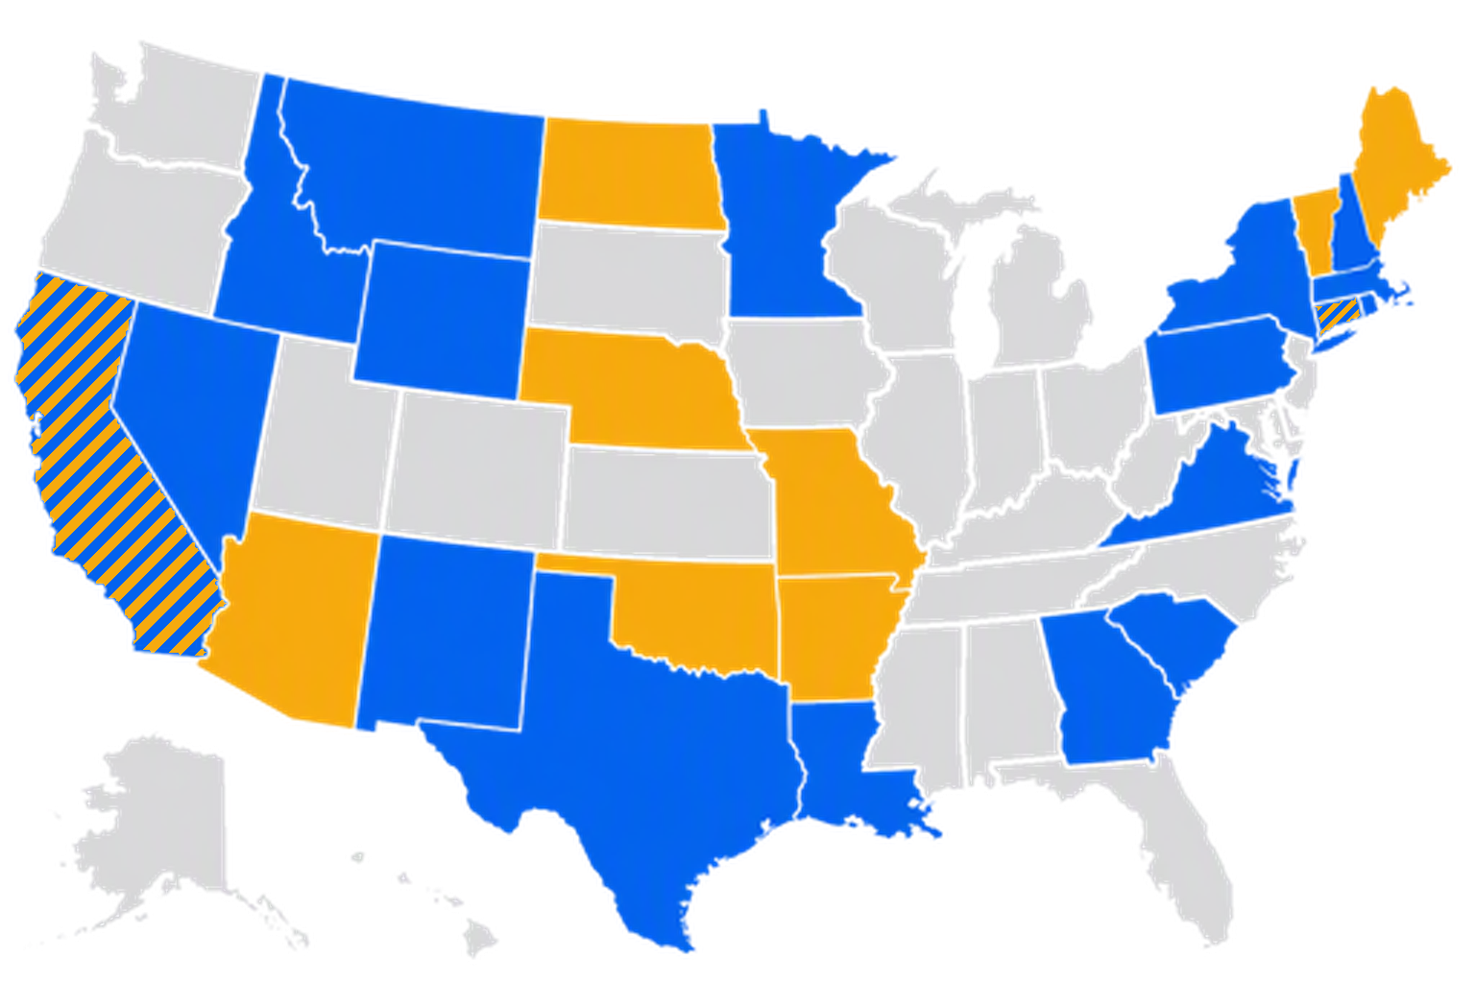

Early Adopter and Cohort 2 Map
PARTICIPATION
Cohort 2
Early Adopters
Split
Notes:
California
Connecticut
Georgia
Idaho
Louisiana
Massachusetts
Minnesota
Montana
Nevada
New Hampshire
New Mexico
New York
Pennsylvania
Rhode Island
South Carolina
Texas
Virginia
Wyoming

Slide 8
Cohort 2: 19 States Confirmed
California
Connecticut
Georgia
Idaho
Louisiana
Massachusetts
Minnesota
Montana
Nebraska
Nevada
New Hampshire
New Mexico
New York
Pennsylvania
Rhode Island
South Carolina
Texas
Virginia
Wyoming

Slide 9
Adoption Timeline
WE ARE HERE
▼
2024 - 2025
Late 2026 - Early 2027
Early to Mid 2027
TBD
TBD
Compact
Early Adopters
Cohort 2
Remaining States
Plan Mgmt
Innovators
10 States
Next Wave
Bulk Migration
H & NA TOIs
Platform validation
with Insurance Compact
Staggered rollout
for selected state instances
Cohort 2 states finalize planning and begin moving to production
All workload in new system except H and NA TOIs and Plan Management
Final transition and retirement of Legacy SERFF
COMPLETE
IN PROGRESS
UPCOMING
FUTURE
PLANNING

Slide 10

Announcing Our First State
FIRST STATE TO GO LIVE
Arizona
Arizona will be the first state to go live on the new platform, with a launch date of October 5, 2026!

Slide 11

BREAKING NEWS
Northern Mariana Islands: Direct to New SERFF
What’s Happening:
CNMI is joining SERFF for the first time – going directly onto the new platform
Filings currently handled via paper and email will transition to electronic submission
Implementation tasks are beginning; launch date is TBD
Who Files in CNMI:
Around 14 domestic and 40+ foreign insurance carriers licensed in CNMI
2 alien insurers with active filings
Health insurance filings make up the majority of submissions
What to Expect:
Companies will file rate and form submissions through new SERFF
Onboarding and training provided as CNMI goes live

Slide 12
Platform Development

Slide 13
How Our Team Improves the Application
OPERATING MODEL
How we decide what to work on, then design, build, test, and release improvements that strengthen the application.
Planning cadence: from priorities to releases
How work gets prioritized
QUARTERLY
Feedback from users helps shape priorities — balanced through common filters.
Set priorities
Sets priorities from program goals, user feedback, quality needs, and technical dependencies.
User impact, timing, and urgency
WORK CYCLES
Must / Should / Could tradeoffs
Break priorities into smaller work
MVP and Day 1 scope decisions
Turns priorities into manageable pieces the team can design, build, test, and release.
Consistency across the application
DELIVERY
Platform stability and supportability
Builds and hot fixes
Frequent builds support continuous delivery.
Feature flags help manage rollout safely
Operating principle: the team brings technical expertise; industry, state, and user feedback provides business context so we can increase feature richness and quality while keeping a uniform, stable experience.

Slide 14
Q3 Work: Application Improvements and Quality
Q3 WORK
Focused improvements that make the platform faster, more complete, and higher quality for all users.
Improving the application users rely on every day
Preparing the platform to scale
01
Faster high-use experiences
Richer, higher-quality features
Targeted performance work on the pages and actions filers use most.
02
Maturing amendments
Core workflows, public access portals, and configuration patterns are being readied for broader use.
Completing and polishing the full lifecycle for core filing workflows.
03
Industry & state feedback
Improve
Validate
Scale
Input from industry and state users is reviewed, prioritized, and built into ongoing improvements.
Q3 focus: improve the experience users feel every day while strengthening application quality and readiness for broader use.

Slide 15
Faster, Steadier, and More Secure
Everyday Speed
Reliability and Security
Where most of our time went – making the screens you use every day respond faster.
The busiest pages first – filing information, documents, fees, review, companies and states, and quick browse.
Fewer waits and hang-ups – behind-the-scenes tuning removes the slow spots users noticed most.
Tested under real pressure – we now test with many users at once so speed holds up as more states join.
A stronger foundation – the system moved to modern hosting that scales as usage grows.
Security kept current – software components are updated regularly and known issues are fixed quickly.
Simpler account setup – user accounts are now created and updated automatically instead of by hand.
More thorough testing – automated checks run before every release to catch problems early.
What this means for you – a system that feels faster, stays available, and keeps your information secure.

Slide 16
Recent Work: What Filers and Reviewers Get
New Capabilities
A Better Everyday Experience
Payments – credit card payments are live end to end, with reporting for NAIC and industry.
Rate data – entry, editing, and validation on draft filings, with compliance issues generated from rate data.
System connections – expanded ways for company systems to exchange filing, fee, and rating information directly.
Automatic updates – connected systems can now receive filing notifications without manual checking.
Amendments improvements – a new experience with change history and document compare.
Compliance issues – industry downloads, rich text, and quick text added.
Faster filing setup – Associated Filings wizard, multi-file upload, and multiple company and TOI selection.
AI in documents – Form Schedule classification is now AI-based, with a clear indicator when a user overrides it.
Why it matters – the work concentrates on the tasks filers and reviewers repeat most often.

Slide 17
On the Horizon: Q4 and Q1
Ability to change TOI and SubTOI
Management dashboard
Improved access across organizational divisions
Further amendment improvements
Ongoing usability improvements
Extending state settings and business rules
Filing reusability with project and product concepts
Document search improvements
And more!
Tentative – these items are targeted for Q4 and Q1 and may shift as priorities and feedback evolve.

Slide 18
Managing Change

Slide 19
What Co-Existence Means for Filers
Filing in Two Systems
What Stays the Same
Follow the state – file in the new platform for states that have moved, and in legacy SERFF for those that have not.
Dates come in advance – each state's transition date is shared ahead of time so you can plan.
Some filings stay in legacy – health filings and plan management move in a later phase.
Multi-state filers plan ahead – expect a period of working in both systems.
Your filing history moves with you – existing filing data is migrated, not left behind.
No surprise cutovers – legacy SERFF stays available until your states have transitioned.
One modern system ahead – as more states move, more of your work happens in one place.
Retirement comes last – legacy SERFF is retired only after the final workloads move.
The takeaway – co-existence is temporary and planned, and you will always know which system a state is using.

Slide 20
Preparing Your Team for the Move
Getting Your Filers Ready
Support You Can Count On
Training built for industry – filer-facing sessions and materials accompany each state transition.
Know what changes – guidance highlights what is different in the new filing and amendment workflows.
Materials keep improving – training content is more mature with every wave of states.
A predictable rhythm – regular communication so you know what is coming and when.
Somewhere to bring questions – a clear channel for filer questions and issues during the move.
Your feedback shapes the build – industry input is tracked and feeds directly into upcoming releases.
The takeaway – no filer moves without preparation, guidance, and people to call.

Slide 21
CLARA
Compliance Language Assistant for Regulatory Analysis

Slide 22
What CLARA Does and Does Not Do
What CLARA Handles
What Stays Human
Reads the filing – compares filing language against the rules the review team has encoded.
Flags likely gaps – surfaces where a filing may not meet a standard.
Shows its work – returns a pass or fail along with the basis for the finding.
Applies rules consistently – the same standard is checked the same way every time.
Reviewers set the rules – CLARA only checks what regulators tell it to check.
Context and nuance – judgment about intent and circumstance stays with the reviewer.
The final decision – CLARA never approves or disapproves a filing.
Ongoing refinement – reviewers tune the rules as they see results.
The short version – CLARA is a review assistant for regulators, not a decision maker.

Slide 23
How CLARA Learns and How It Is Used
Training CLARA
Using CLARA Today
Pick one rule – a reviewer starts with a single, clearly defined requirement.
Show both sides – compliant and non-compliant examples teach the pattern.
Test the results – CLARA is run against known filings to see how it does.
Refine and repeat – the rule is tuned until the findings hold up.
Choose a rule set – the reviewer selects which standards to run.
Upload the document – CLARA can read any PDF submitted for review.
Get a clear result – pass or fail, with the basis for each finding.
The reviewer acts – a person decides what happens next.
Built and run at the NAIC – CLARA lives entirely inside NAIC infrastructure, behind single sign-on.

Slide 24
Where CLARA Is Today and What Is Next
Today
Next in 2026
In reviewers' hands – state reviewers are using CLARA on real filing documents.
Lightweight by design – it works alongside SERFF today rather than inside it.
A growing rule library – new standards are added as reviewers encode them.
Feedback drives it – reviewer results shape every refinement.
More rule types – broadening the standards CLARA can check.
SERFF integration – moving from manual uploads toward filings CLARA can reach directly.
Findings for filers – a longer-term goal of a pre-submission check.
See it live – a CLARA workshop at the Insurance Summit, October 1–2 (Regulator Only)
Why filers care – faster, more consistent state reviews now, with earlier feedback ahead.

Slide 25
What CLARA Means for Industry
Impact on Your Filings
What Filers Can Expect
Faster reviews – standards are checked in minutes rather than line by line, shortening time to a first response.
Fewer surprise objections – the same standard is applied the same way in every review.
Clearer questions – reviewers see the basis for each finding, so requests back to filers are more specific.
Less rework – issues surface earlier in review, reducing repeated amendment cycles.
A pre-submission check – a longer-term goal of letting filers see findings before they submit.
Built into the filing flow – moving toward checks that run on filings directly instead of manual uploads.
Broader coverage – more standards encoded as states add the rules they review most often.
A person still decides – CLARA never approves or disapproves a filing; regulators make every call.
The takeaway – filers see the benefit in the review itself, and the direction is toward fewer surprises at submission.

Slide 26
How the CLARA Process Advances
1
2
3
4
Pilot
Operational
Integrated
Pre-Submission
Training & Testing
Everyday Review
Inside SERFF
Filer Feedback
States train on CLARA and test rules against real filing documents
States move from testing to using CLARA as a regular part of filing review
CLARA connects to the new SERFF platform so assisted review runs automatically in the workflow
When rules prove highly accurate, states can enable them so companies get feedback before submitting
WHERE WE ARE
NEXT STEP
THEN
WHEN READY

Slide 27
Additional Material
Health Filings

Slide 28
Impacted Health TOIs at a Glance
Tied to Binders
Added for Plan Management
No Direct Dependency
H02 G&I
H03 G&I
H06
H07 G&I
H10 G&I
H15 G&I
H16 G&I
H17 G&I
H20 G&I
H21
HOrg02 G&I
HOrg03
HOrg04 G&I
HOrg05 G&I
NA01
8 TOI groups
H04
H12
H22
H23 G&I
H24 G&I
H25 G
H26 G&I
HOrg06 G&I
10 TOI groups
H01
H05
H08 G&I
H09 G&I
H11 G&I
H13 G&I
H14 G&I
H18 G&I
H19 G&I
HOrg01
15 TOI groups
How to read this – the first two groups have dependencies that require them to stay in Legacy SERFF.

Slide 29
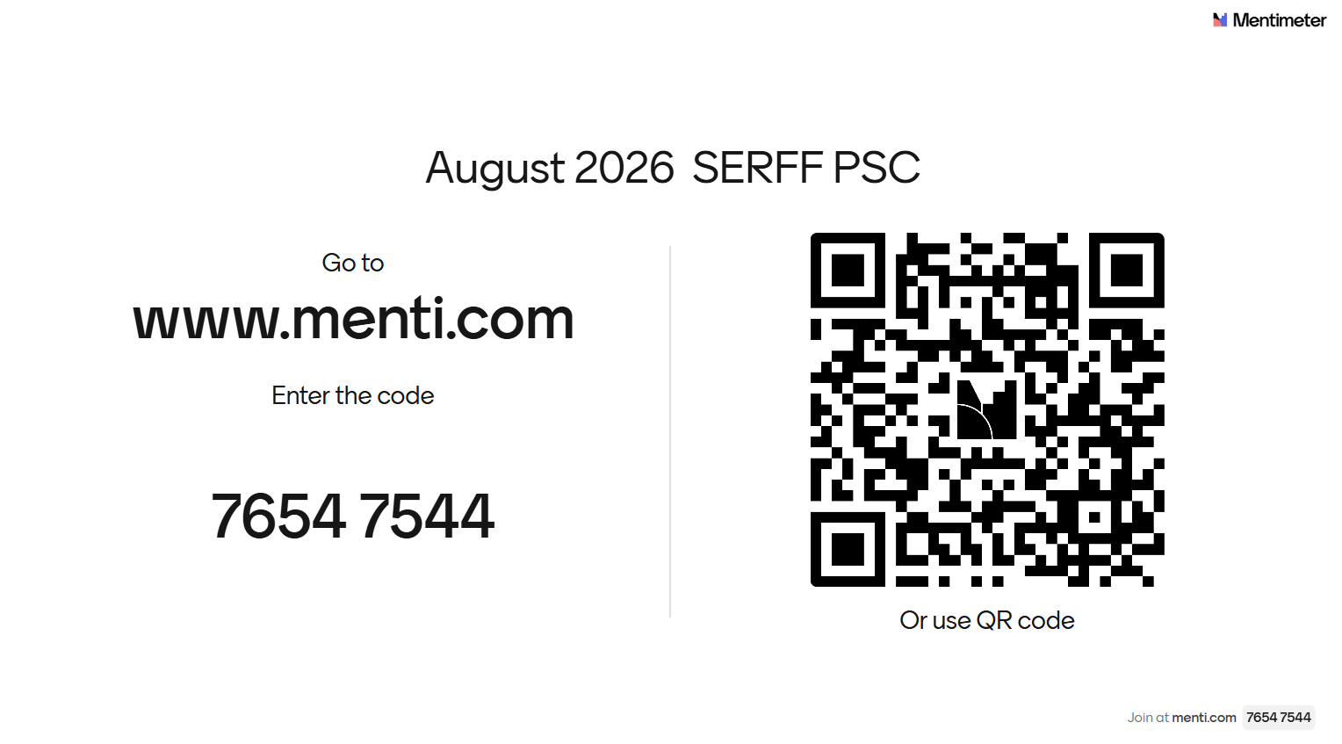

Slide 30
Thank You

