Slide 1
A different view on Medicare (Dis)Advantage
Barbara McAneny MD FASCO MACP
CEO New Mexico Oncology Hematology Consultants Ltd
Former President American Medical Association
Chair of National Cancer Care Alliance

Slide 2
Disclaimer: Anecdotal experience only
My opinions are strictly my own.
There is no published literature that I can find describing the processes I have encountered, and that I have heard described from other practice managing partners or physicians.
I have no financial conflict of interest, with no investments in any companies that invest in MA plans.
My payment is the same from MA plans and FFS Medicare.

Slide 3
Intent of this presentation
I am a cancer doctor, and I have seen a significant deterioration of benefits for cancer patients and others with serious illness.
NAIC is the only organization outside of CMS that has any ability to provide oversight of MA plans so my hope is for regulations that allow patients to select a plan that is honestly marketed and lives up to expectations.

Slide 4
What information formed my opinion
1. Physicians employed by Managed care companies
2. Delays in prior authorization by MA companies
3. Attempts to participate in ACOs, or be on the board
4. Discussions with other cancer practices
5. Discussions with physicians employed by hospitals that also have MA or other insurance plans.
6. My Governor’s Task Force on Drug Pricing

Slide 5
Why I call it Medicare Disadvantage
1. Managers of the plans benefit from enrolling healthier seniors and finding HCCs that increase the monthly payment from CMS
Gym memberships and dental care
Primary care doctors I have tried to hire tell me their job is more to find HCCs than to treat patients
Step therapy is a deterrent to patients with serious illness
2. Managers of the plans benefit from delaying care for enrolled seniors
Especially near open enrollment, when sicker patients can switch to FFS Medicare
3. Managers of the plans benefit from higher drug prices as those increase the MLR and they can get rebates from their PBMs
Co pay accumulators and Maximizers.

Slide 6
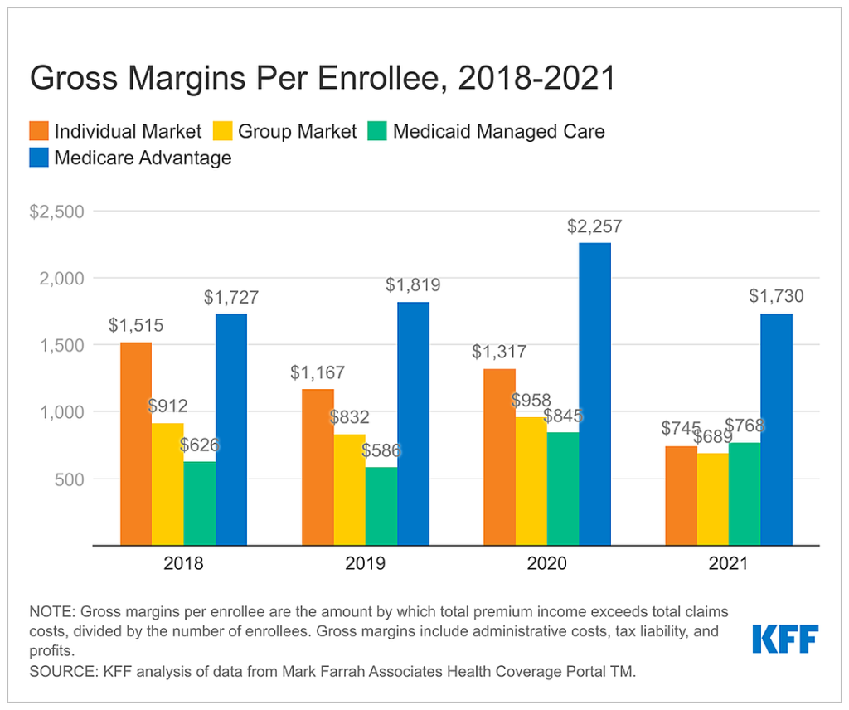
2/23 Kaiser Family Fund 2021

